Slide 1
Open Enrollment Plan Year 2024
Open Enrollment:
November 1, 2023, through November 30, 2023 Coverage Periods: Health Plans - December 24, 2023, through December 21, 2024 FSAs elections – January 1, 2024, through December 31, 2024- Must enroll each year, plans do NOT roll over
HSA changes and enrollments are effective beginning January 1, 2024

Slide 2
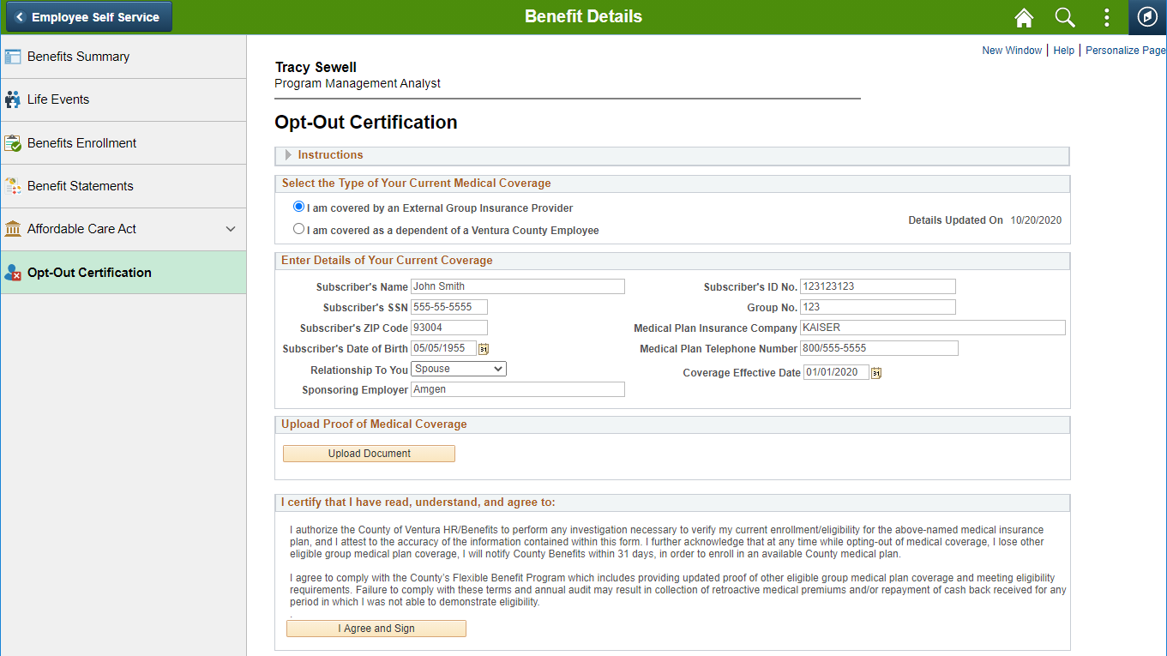
Current Medical Opt-Out Re-Certification Required during Open Enrollment
Current and new Medical Opt-Out participants should receive an email to certify/recertify their medical opt-out information. Follow the instructions on the email, which says to navigate to the Opt-Out Certification page and enter your medical opt-out details as well as upload documentation.
Current medical opt-outs must recertify during Open Enrollment Nov 1st – 30th or will be enrolled in a plan.

Slide 3
Important Information
•All County Sponsored Medical Plans in 2023 continue to be offered in 2024 with no vendor or plan design changes, as well as an increase to the annual contribution amounts for FSAs and HSA accounts.
•If you do NOT want to make any plan changes, and you do NOT want to be enrolled in any Flexible Spending Accounts, no action is required. Your coverage will roll over to the 2024 plan year.
•However, if you are currently enrolled in any Flexible Spending accounts and want to be enrolled in them in 2024, you must make a new enrollment. IRS requires a new enrollment election by the employee each year for all FSA plans. FSA enrollment NEVER rolls over from year to year.
•If you are currently enrolled in an HSA plan and continue to be eligible because you are enrolled in a County High Deductible Health Plan, your HSA enrollment will roll over to the 2024 plan year unless you change your election or terminate your enrollment in the plan.
Note: As stated previously current medical opt-outs must recertify in VCHRP, Employee Self-Service, Benefit Details, Opt-Out Certification.

Slide 4
Are you adding any dependents to your health plans?
If you enroll a dependent who has not previously been enrolled in one of your health plans, you must provide proof of dependent documentation (i.e., birth certificate, marriage certificate, most recent tax return with dependents listed) as soon as you make the open enrollment change, and no later than 5:00 p.m. November 30th, or the dependent will be termed as if never enrolled.
Send email with the documentation to: Benefits.ServiceRep@ventura.org.
Include your Employee ID#
Name
And “OE Dependent Proof” in the subject line
If multiple pages are being submitted, they should be submitted as one document.
Use a delivery and read receipt if you would like proof of receipt. Contact your agency HR Department if you need help with this.

Slide 5
2024 Medical Plan Rates Per Pay Period

Slide 6
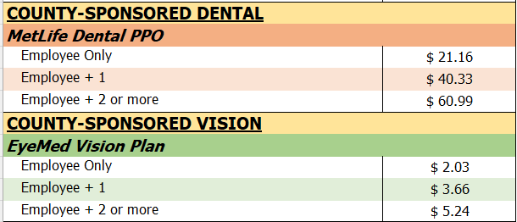
2024 Dental and Vision Plan Rates Per Pay Period

Slide 7
Flexible Spending Accounts (FSA)
Non-taxable accounts for the purpose of reimbursement of eligible expenses. FSA accounts are use it or lose it, meaning that any funds left unused at the end of the year/grace period are forfeited. See complete details in Chapter 5 of the Benefits Plans Handbook.
FSA accounts available:
Health Care (Health Care expenses for you and your family)
Limited Purpose HealthCare (HDHP/H.S.A. enrollees only)
Dependent Care (Daycare Expenses dependents to age 13 & qualifying disabled dependents)
Link to image info
Notes:
You also have the option to contribute to a Flexible Spending Account – There are two types available, Dependent Care and Health Care.
Dependent Care
If you pay for dependent care so that you or your spouse can work or attend school, you may set money aside in a Dependent Care Flexible Spending Account to reimburse yourself for eligible expenses.
You enroll in this account when you sign up for your benefits as a new employee or during the annual open enrollment period, during November. This account can also be used for adult dependents as well as children.
Health Care
With th Health Care FSA you may set aside funds, tax-free, to cover eligible health related expenses, that are not reimburseable by health plans or other sources. Not all health expenses are covered, you must submit documentation with proof of eligibility, in order to receive reimbursement. For detailed information, please review Chapter 5 of the Benefits Plans Handbook.
The advantage of using the Dependent and Health Care FSA, is that the funds set aside are not taxed and the amount deferred reduces your overall taxable income.

Slide 8
Navigating VCHRP Open Enrollment
Step-by-Step

Slide 9
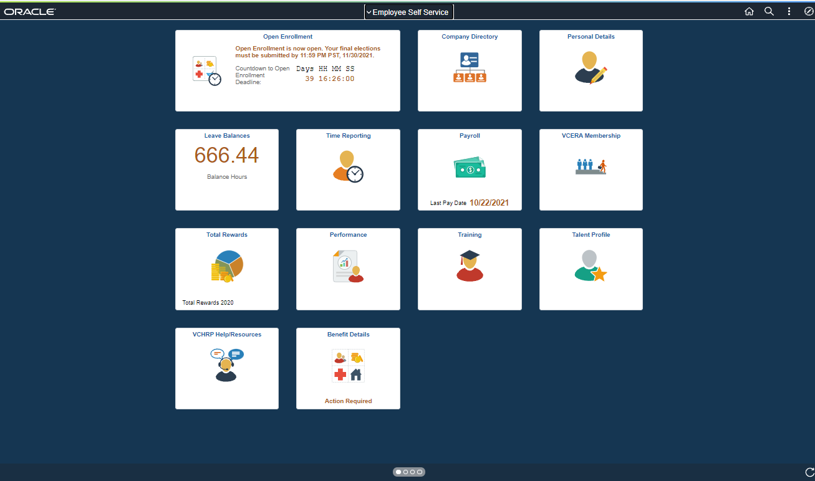
Log into VCHRP
by using the link on the County Benefits Open Enrollment page: https://hr.ventura.org/benefits/py2023
Or at: https://vchrp.co.ventura.ca.us
If you need password or login help and you have not setup the “Forgot Your Password” feature, contact your agency for help. Once logged in make sure to setup Forgot Your Password help for email link retrieval for future login issues.

Slide 10
Open Enrollment Welcome Page
Review the "Welcome" page. If you have not yet reviewed the Benefits Plans Handbook, or need information about any plans, rates or to view the “Who Do I Contact” list to contact the plans directly if you have questions about each plan, you can click on the link provided on this page to the County's Benefits Open Enrollment page.

Slide 11
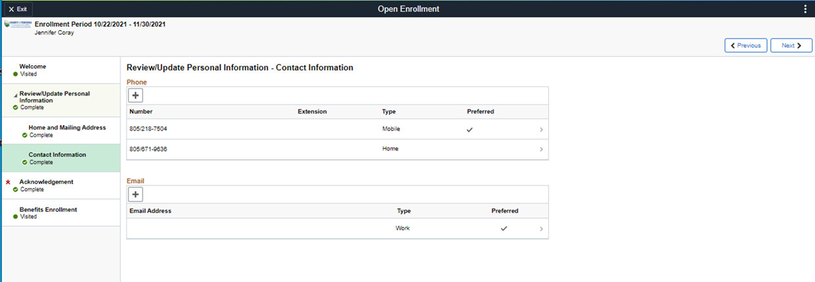
Update Your Contact Information
(If Needed)

Slide 12
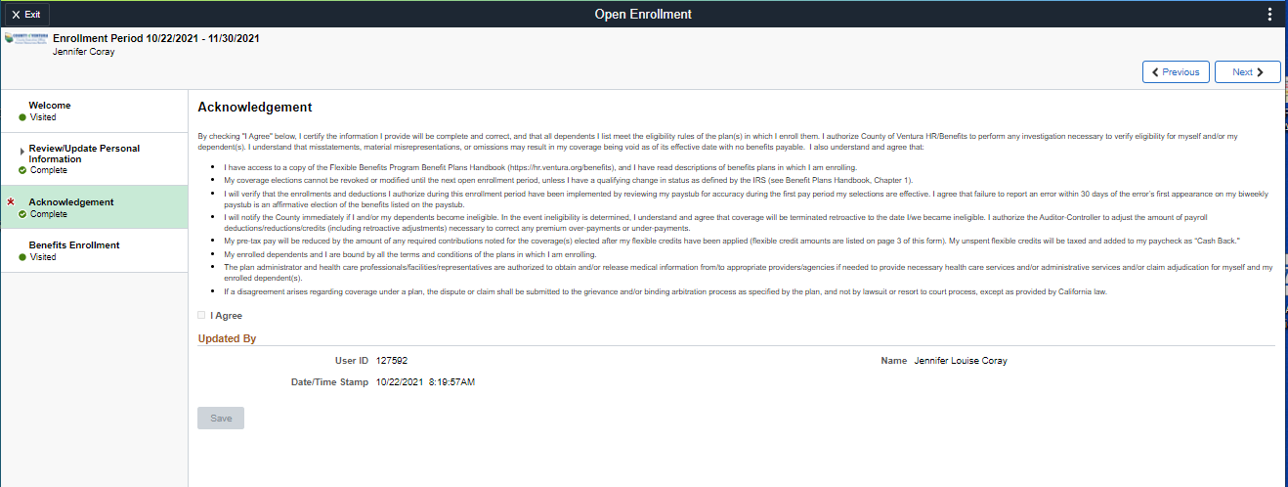
Acknowledgment Page
A Required Step

Slide 13
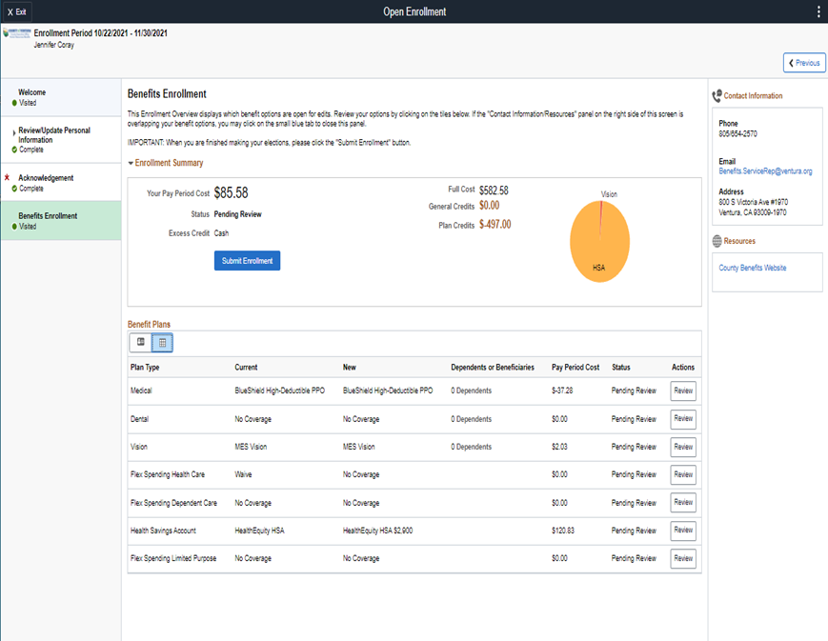
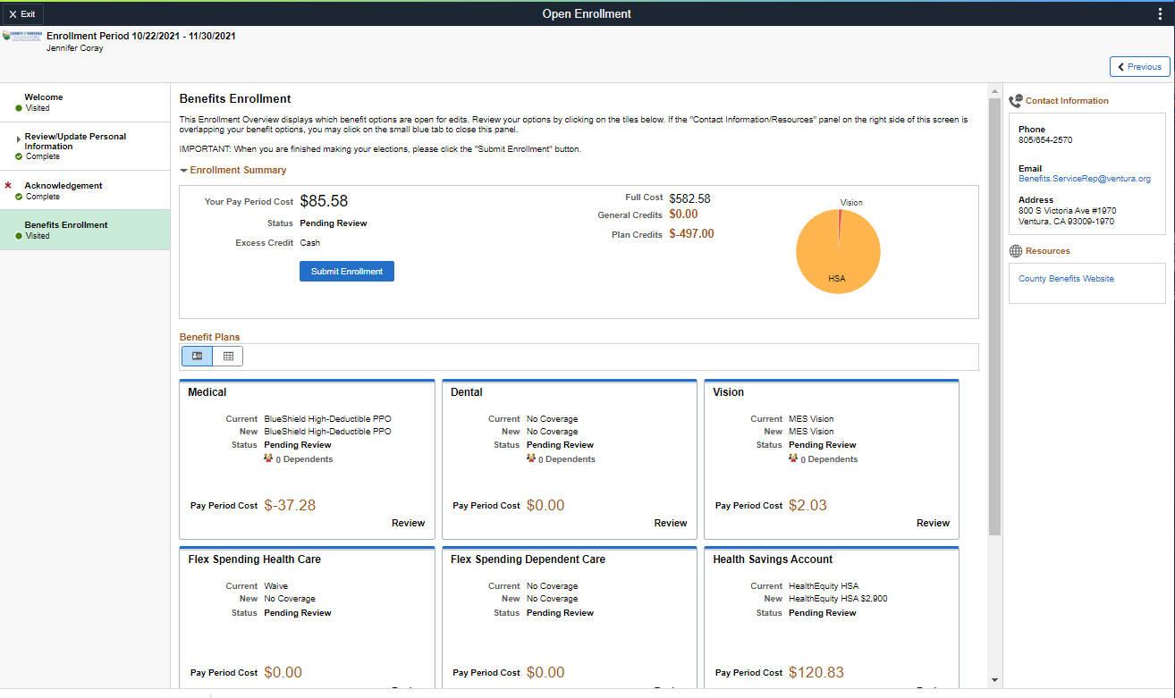
Benefits Enrollment Page
OR

Slide 14
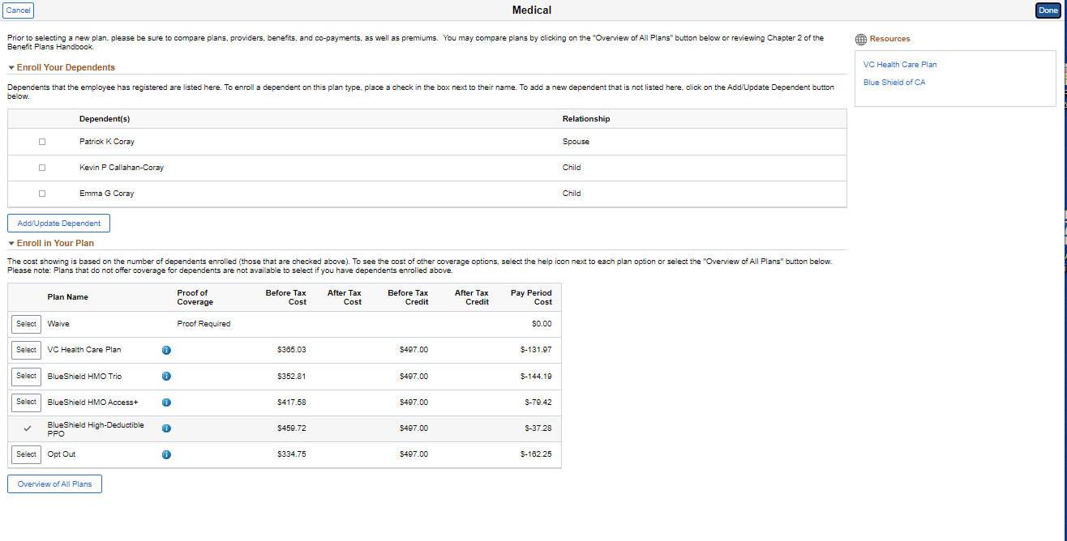

Slide 15
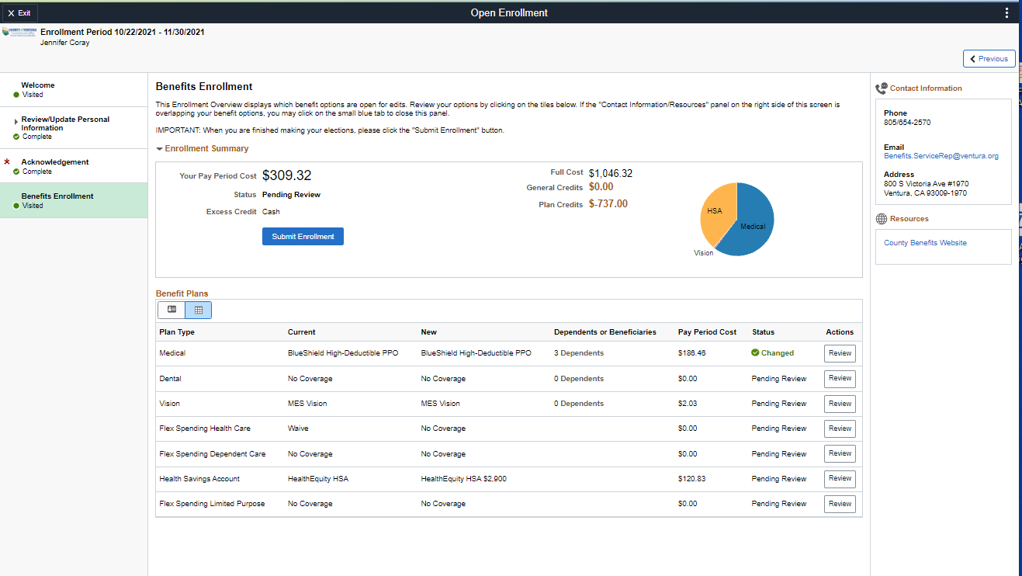

Slide 16
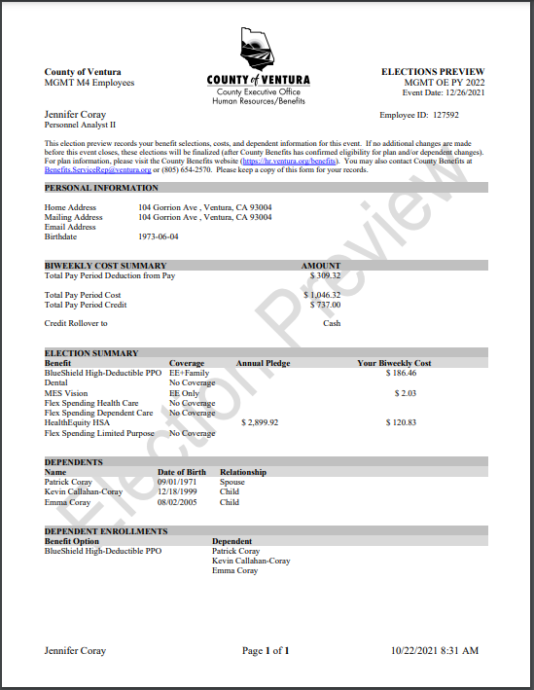

Slide 17
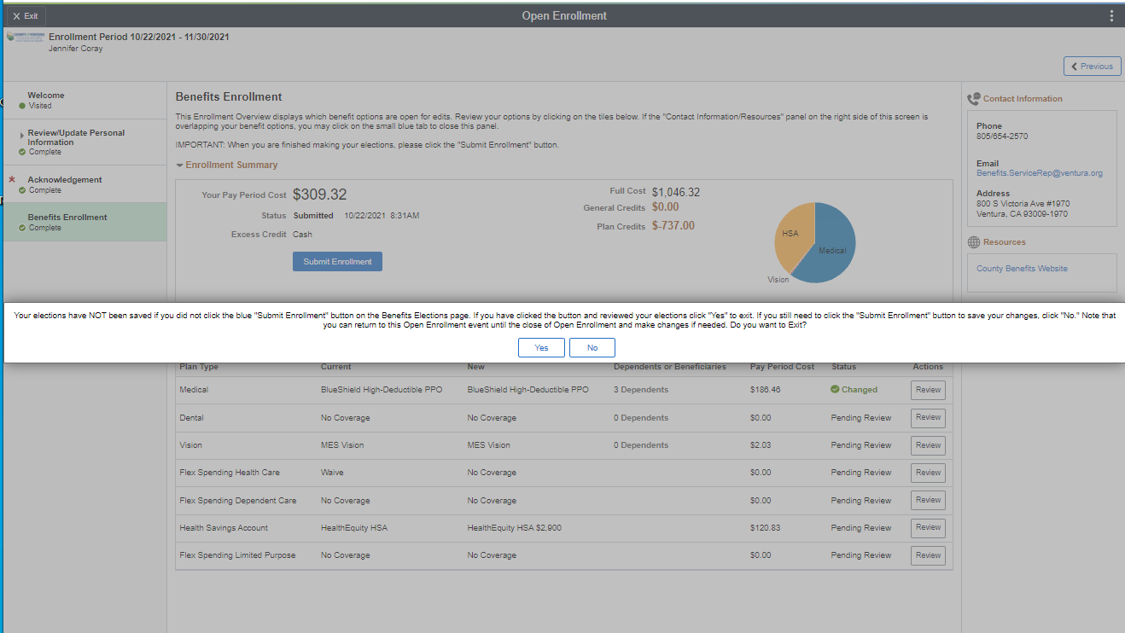

Slide 18
After Open Enrollment Ends

Slide 19
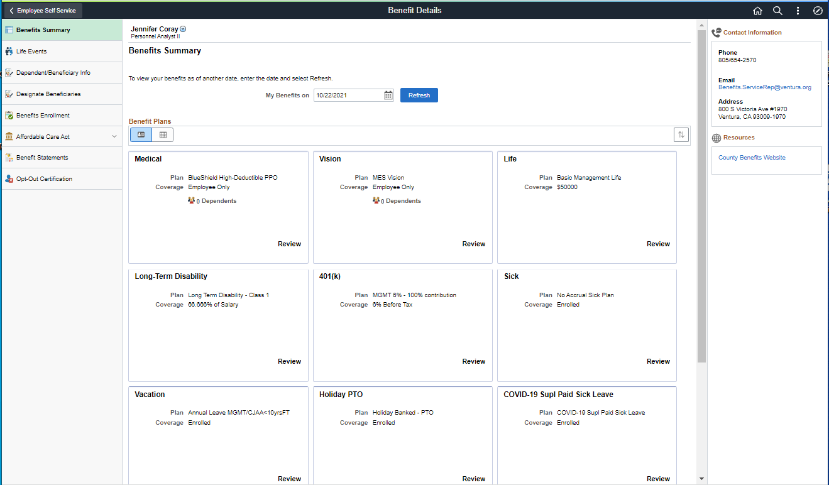

Slide 20
More Information Visit:
https://hr.ventura.org/benefits/py2024
Reference the Benefit Plans Handbook 2024 Benefit Plans Handbook
Contact each plan individually for specific plan questions. Reference the Who Do I Contact sheet on the 2024 Open Enrollment Benefits page link noted above.
_____________________________
Contact your agency’s HR Department Rep found at
HR Department Representative Contact Information found on the Open Enrollment website.
Or
Benefits Service Representative Benefits.ServiceRep@ventura.org, 805-654-2570 if you have questions about the enrollment process.

