Slide 1
Roads & Transportation Oak Park MAC Meeting
March 27, 2025
Notes:
Here are notes for this slide

Slide 2
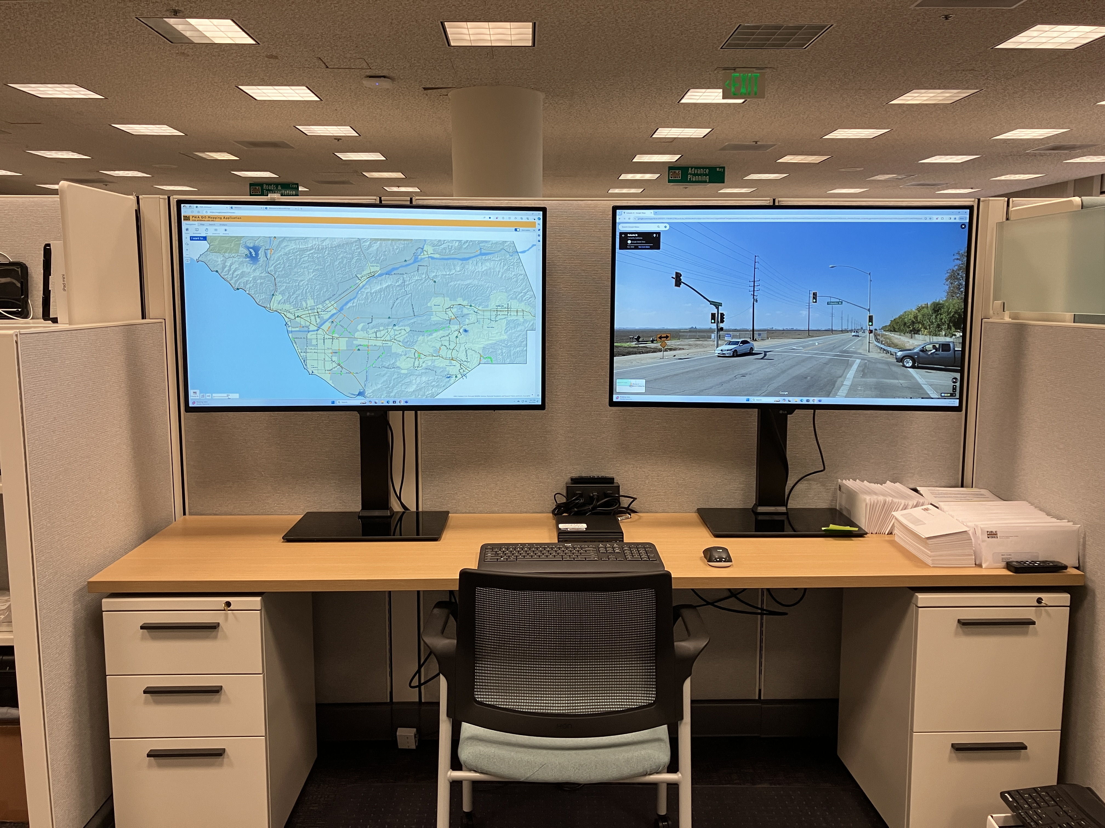
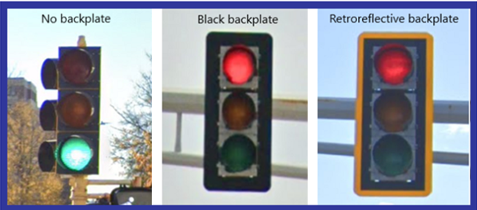
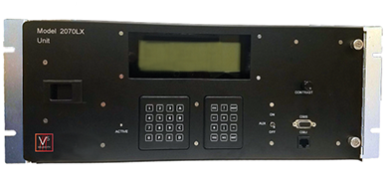
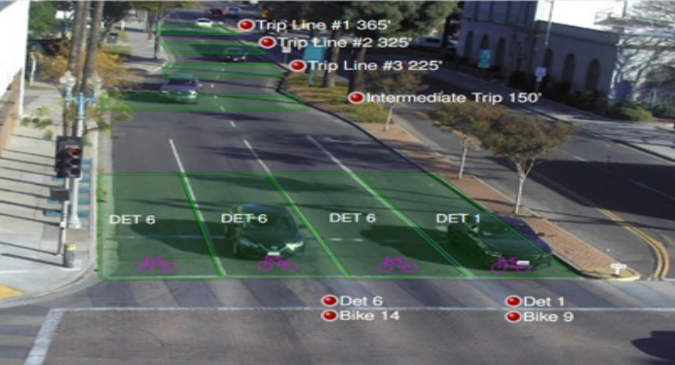
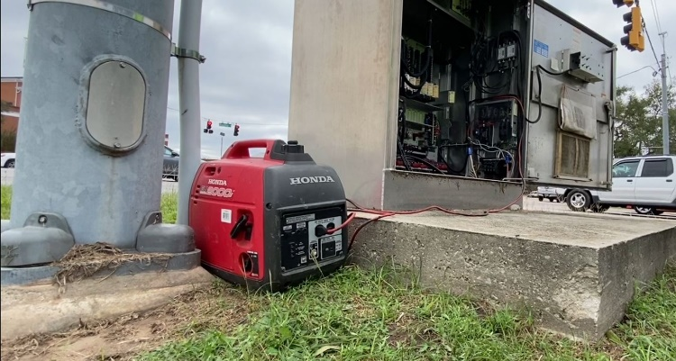
Systemic Signal Improvement Project $6.8M overall, $5.8M from HSIP Grant
Add retroreflective backplates
to all signal heads
New signal controllers
Traffic Management Center
Dilemma Zone Detection Cameras and High friction surface treatment
At the Golden Eagle Dr, Hollytree Dr/ Oak Hills Dr, Deerhill Rd, Sunnycrest Dr, and Conifer St intersections
Backup power for signals

Slide 3
Systemic Signal Improvement Project Schedule – in Oak Park
New Controllers have been installed
Video detection cameras at Golden Eagle Dr, Hollytree Dr/ Oak Hills Dr, Deerhill Rd, Sunnycrest Dr, and Conifer St were installed during the weeks of March 3rd and March 17th.
Mill & fill + Temporary striping at Golden Eagle Dr, Hollytree Dr/ Oak Hills Dr, Deerhill Rd, Sunnycrest Dr, and Conifer St
High Friction Surface Treatment at Golden Eagle Dr, Hollytree Dr/ Oak Hills Dr, Deerhill Rd, Sunnycrest Dr, and Conifer St, 1 day each, mid to late May
Striping restoration, 1 day
Backplates and Signal Heads, half-day at each intersection planned for early May
Anticipated project completion June 2025

Slide 4
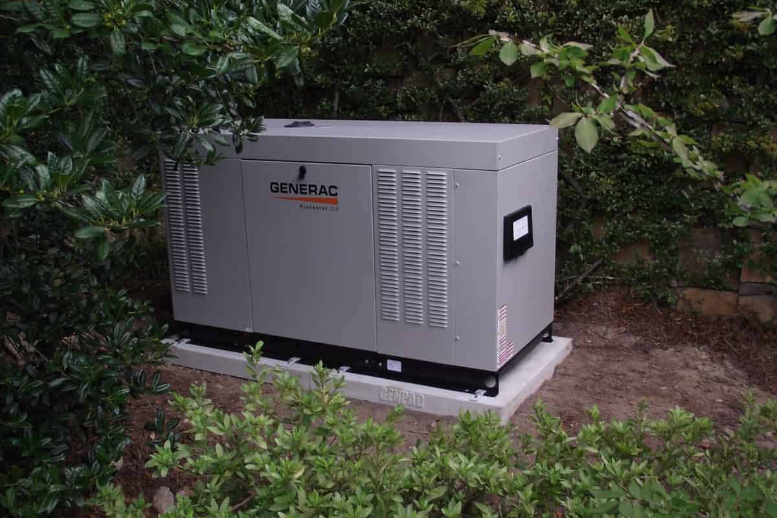
Backup Power for Public Safety Power Shutoff Events
Portable Gasoline Generators
Pros:
Inexpensive
Relatively quiet
Cons:
Manually deployed
Need refueling every 4 hours
Produce Emissions
High probability of theft
Pad Mounted Gas or Diesel Generators
Pros:
Generally larger fuel capacity
Less susceptible to theft
Automatically turned on with power loss
Cons:
Produce Emissions
Need refueling every 8 to 12 hours

Slide 5
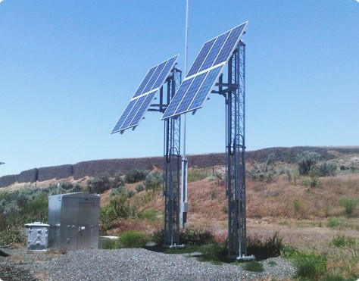
Backup Power for Public Safety Power Shutoff Events
Solar Power
Pros:
No emissions or noise
Cons:
Power generation dependent on fair weather
Solar array can be large
Super Capacitor (like a battery)
Pros:
About 10 hour run time
Cons:
Not effective for extended PSPS events
Notes:
Total 114 ( 78 + 36)

Slide 6
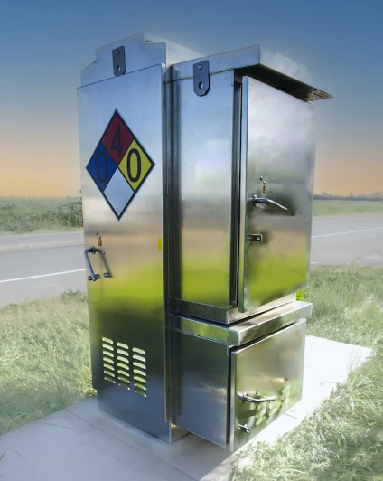
Backup Power for Public Safety Power Shutoff Events
Hydrogen Fuel Cell
Pros:
Can provide 5+ days of power
No noise
Clean water vapor emissions
Cons:
Hydrogen gas cylinders
Notes:
Total 114 ( 78 + 36)

Slide 7
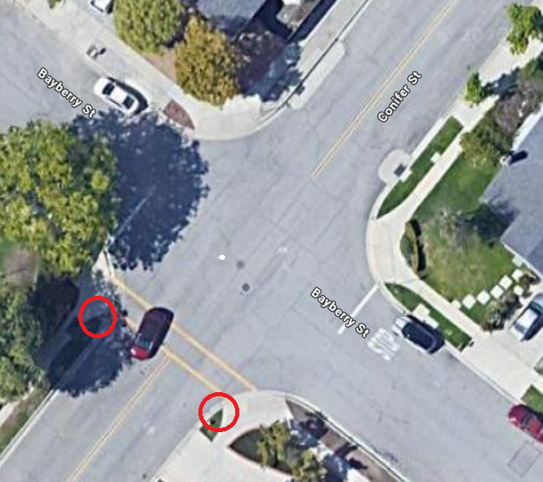
In Progress/Upcoming Projects
Adaptive Corridor Study (Ongoing)
This is a County wide study to determine if the signalized corridors, including Kanan Road are compatible with an Adaptive Corridor design.
Crosswalk Enhancements Countywide (HSIP Grant)
Install Rapid Rectangular Flashing Beacons (RRFBs) multiple locations Countywide
Locations are where there is no stop sign or traffic signal for the vehicular travel direction where pedestrians are crossing
Crossing Conifer Street at Bayberry Street
Additional locations can be evaluated for future Grant cycles
Notes:
Total 114 ( 78 + 36)

Slide 8
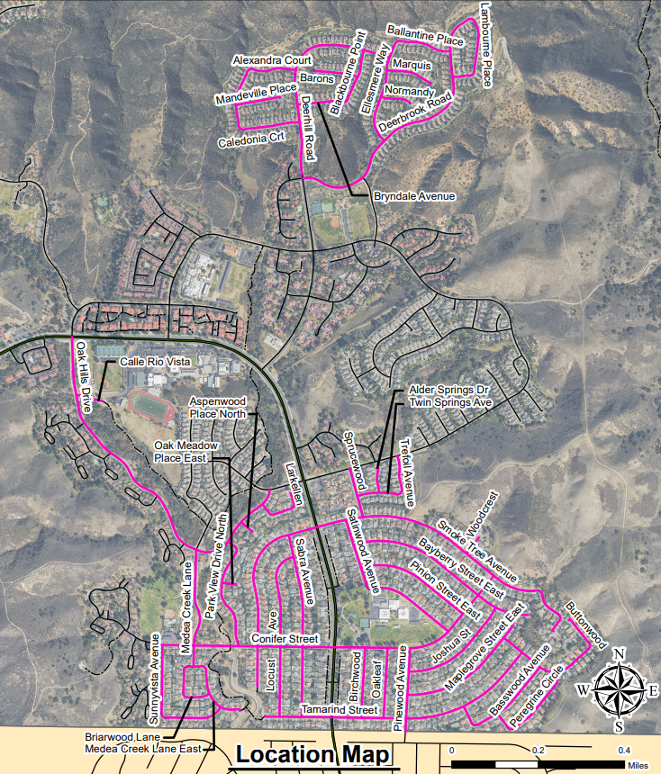
Oak Park Paving
Scheduled Summer 2026
Work will include:
Pavement resurfacing
Repairing Curb & Gutter, Sidewalks & Ramps
Inspectors and an arborist will begin making small marks to identify repairs
In the event a repair or replacement is required, the adjacent property owner will be notified and presented with two options
1. Owner makes the repairs | 2. Repaired w/ County’s project and owner invoiced

Slide 9
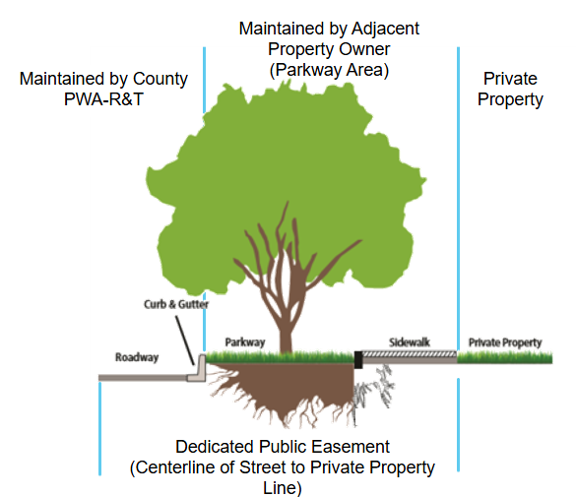
Sidewalk & Tree Maintenance Responsibility
CA S&H Code Section 5610 – Adjacent property owner is responsible for sidewalk maintenance
County Ordinance 4355 – Sidewalk maintenance and liability
1/2" Maximum sidewalk displacement
Priority is to protect trees wherever possible without creating a safety hazard

Slide 10
Los Arcos to Kanan No Left Turn
Background
Oak Hills Elementary contacted PWA-RT to improve traffic safety and circulation in the neighborhood area
Traffic Team evaluated Kanan/Churchwood and Kanan/Los Arcos intersections with input from Oak Park Unified School District, Oak Hills Elementary, and CHP
Churchwood has a traffic signal
Los Arcos Dr is uncontrolled and situated on a curve with high traffic volumes (15,000 vehicles/day), high vehicle speeds (48.5 MPH), and below standard sight distances (350 ft, where 430 ft required for right turns and 600 ft required for left turns)
5 collisions in the prior 10 years with 1 including injuries at Los Arcos

Slide 11
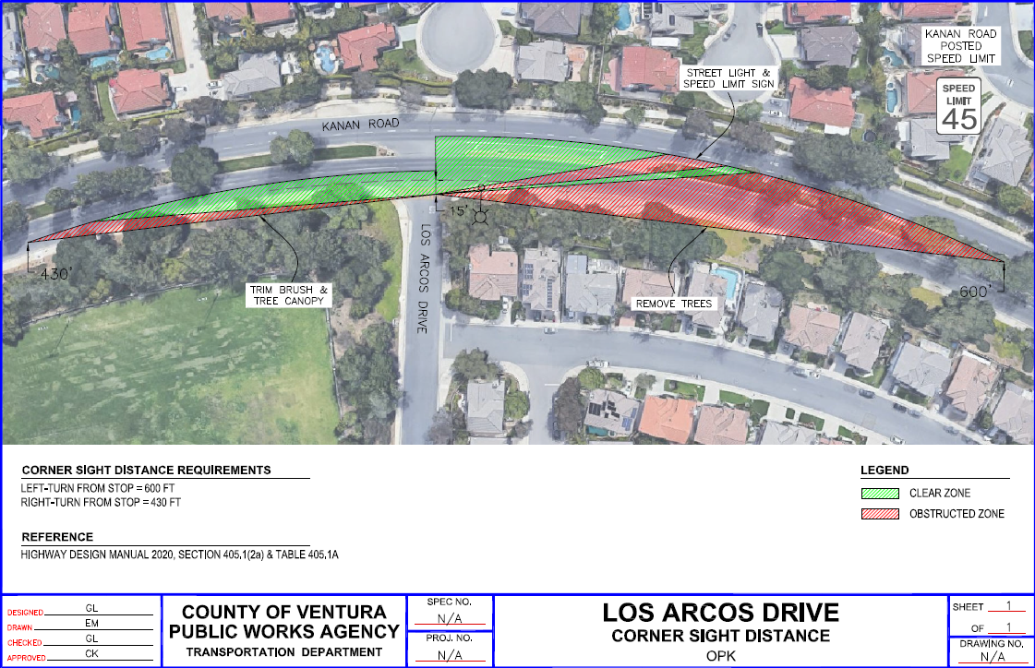
Los Arcos to Kanan No Left Turn

Slide 12
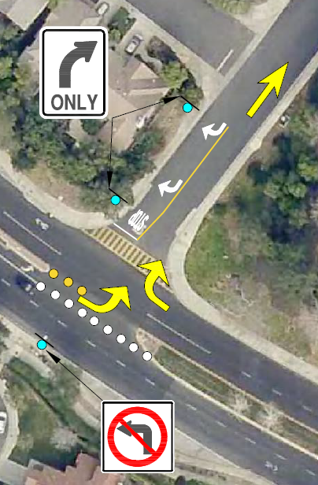
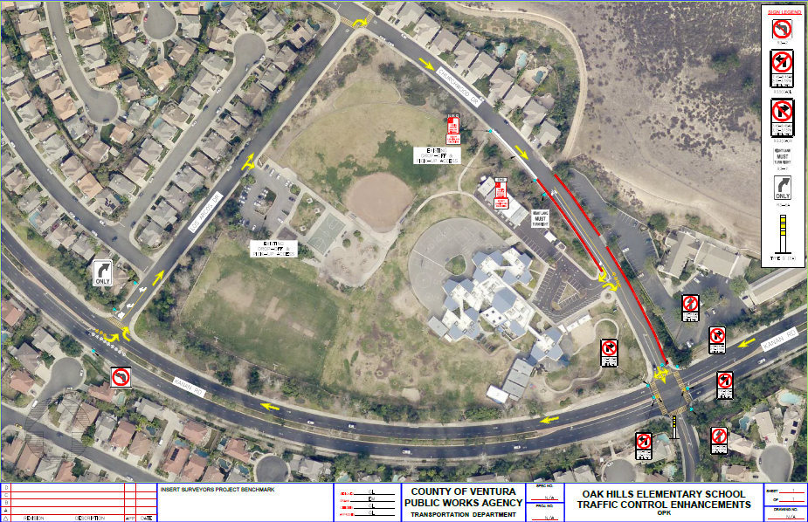
Los Arcos to Kanan No Left Turn

Slide 13
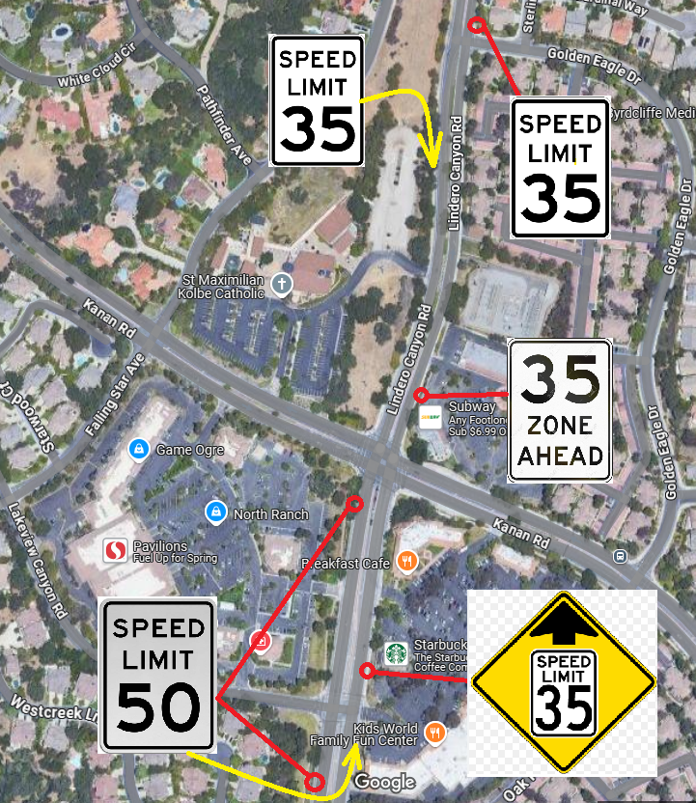
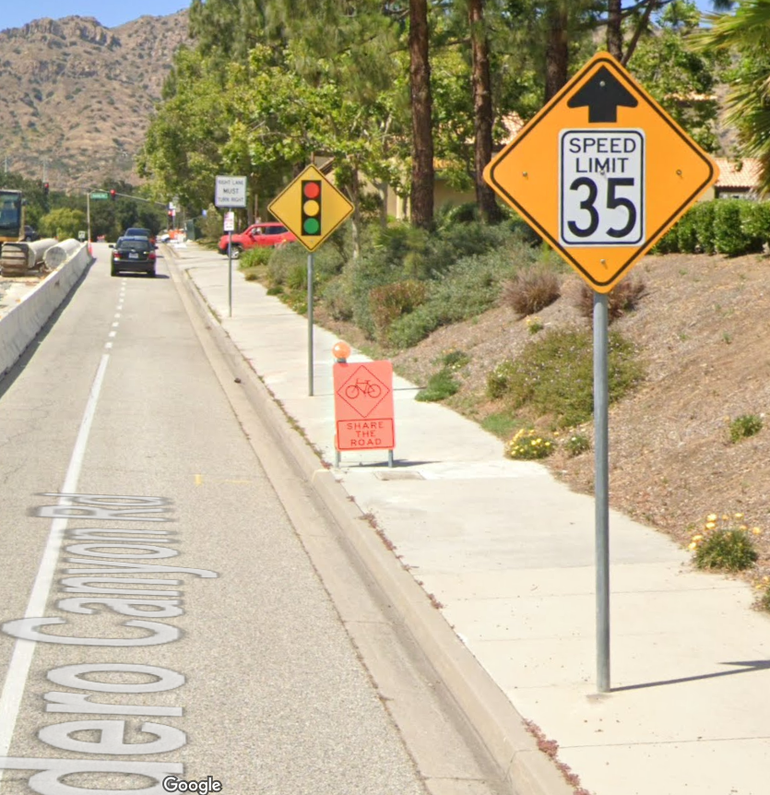
Lindero Canyon Road Speed Limit

Slide 14
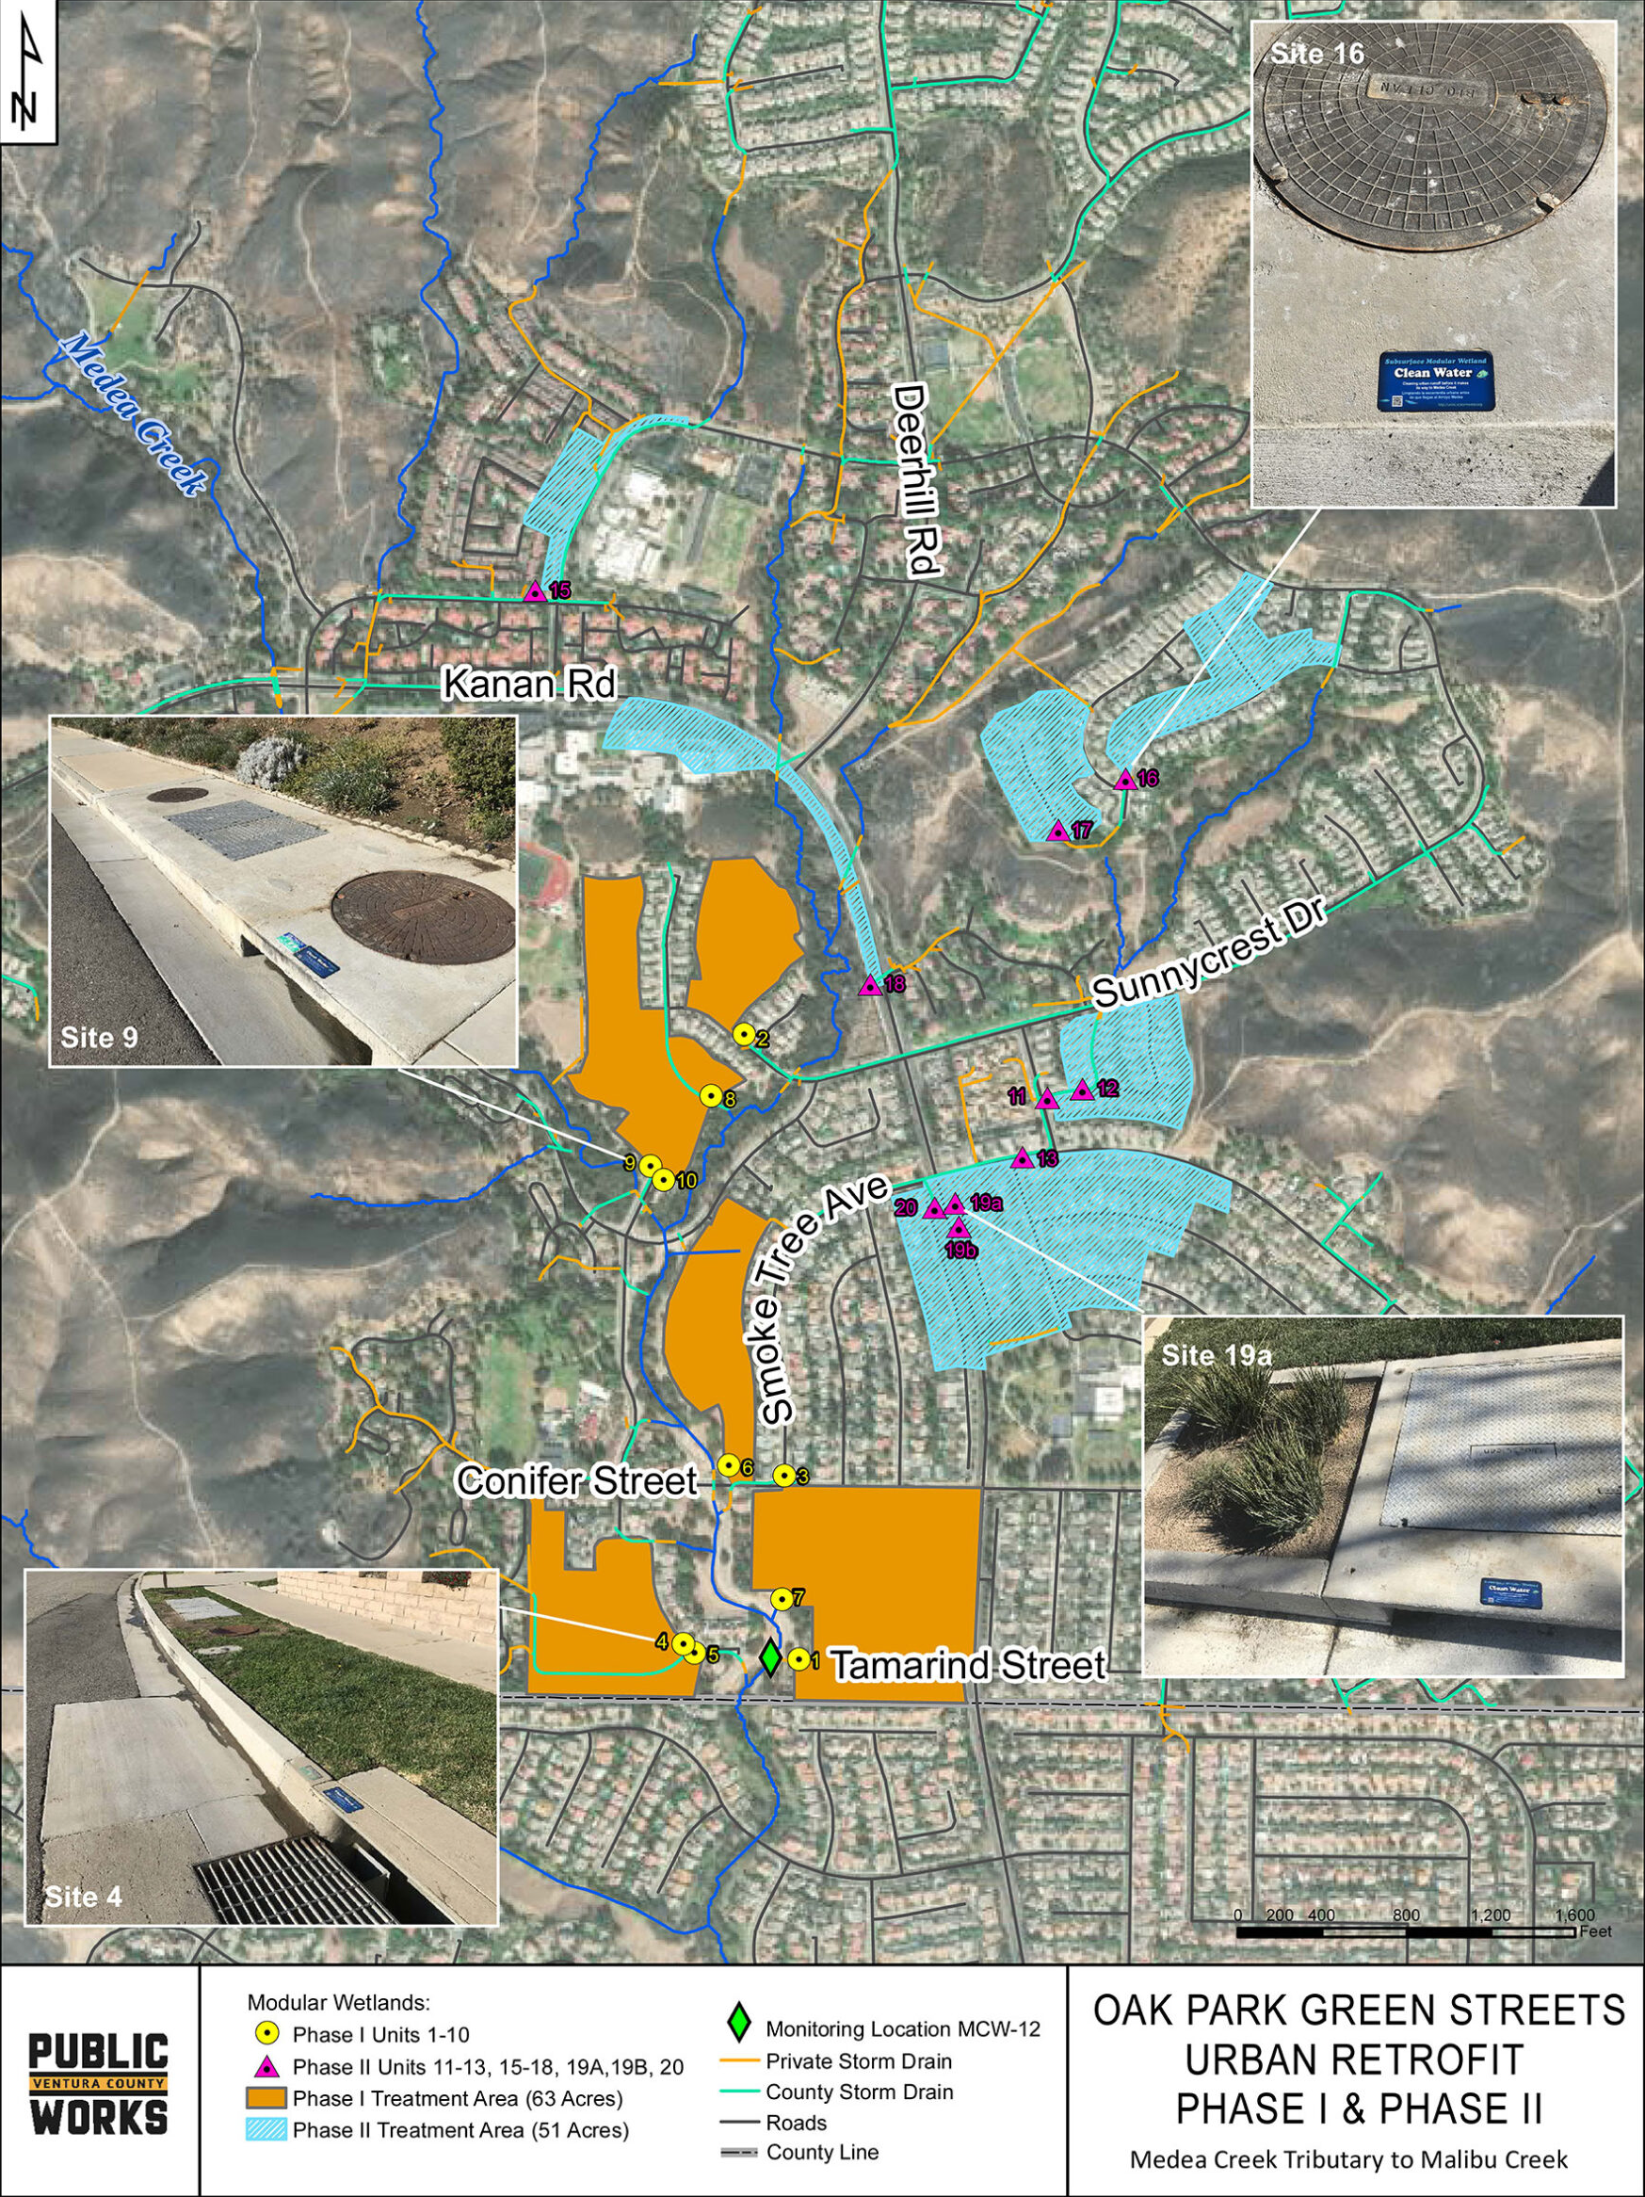
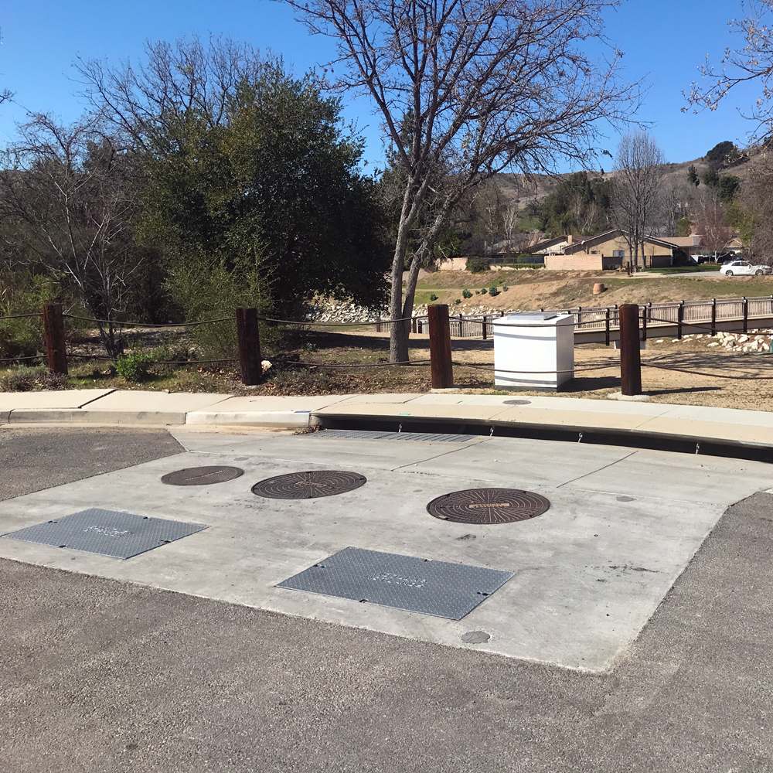
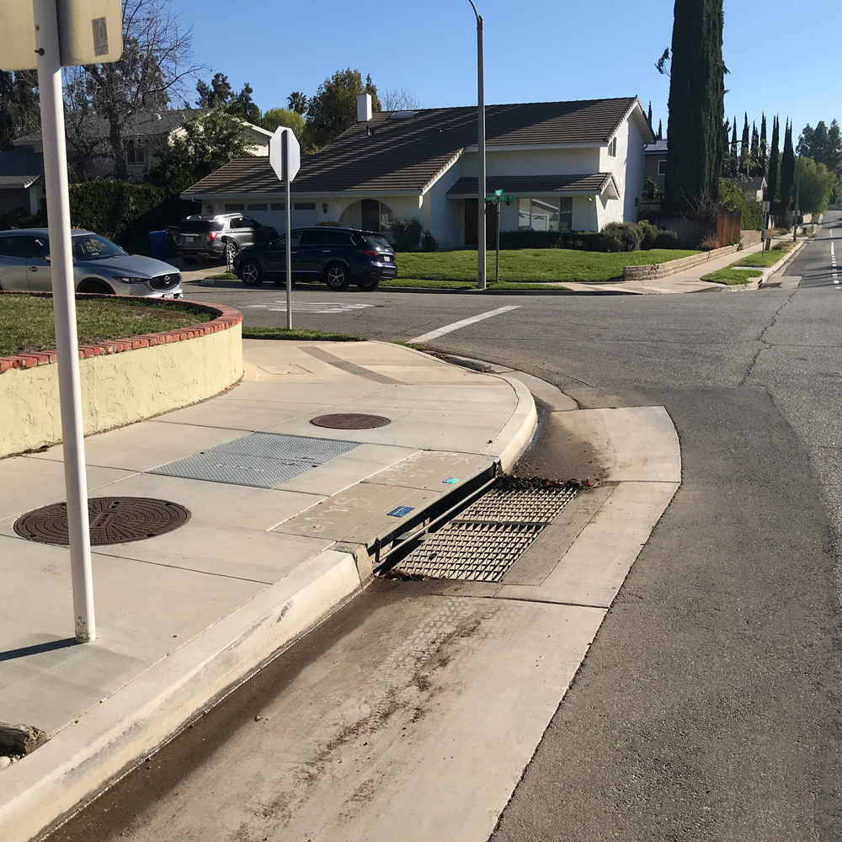
Green Streets Program - Maintenance
Maintenance Costs ($76K for FY26)
CSA#4 funds 50% on going maintenance ($38K)
Other 50% is paid by the general fund contributions
Maintenance cost covers:
Three maintenance events per year
Annual replacement of cartridge filters per project’s O&M plan
Information available on Project’s public outreach website: https://uninc.vcstormwater.org/oak-park-green-streets-urban-retrofit/.
Modular Wetland– Tamarind St
Modular Wetland– Parkview Dr & Conifer St
Notes:
The Oak Park Green Streets Urban Retrofit project
The Oak Park Green Streets Urban Retrofit project is located in the unincorporated community of Oak Park in the County of Ventura, California, and within the Malibu Creek Watershed. This urban retrofit project includes 20 subsurface filtration systems, proprietary modular wetlands® installed within the County’s right-of-way to treat nuisance flows from residential areas. Phase I of the project, including installation of 10 modular wetlands®, was completed in November 2017, and Phase II, including installation of an additional 10 units, was completed in February 2021. The total project will treat an estimated 35 acre-feet of dry weather runoff per year from a combined tributary drainage area of approximately 114 acres.
What is a Modular Wetland®?
A Modular Wetland® is a pollutant removal system for solids, bacteria, oil/grease, nitrate, copper, zinc, and other common urban pollutants. The horizontal flowing biofilter efficiently utilizes a combination of physical, chemical, and biological filtration processes to capture and treat nuisance flows.

Slide 15
Modular Wetland System

Slide 16
Questions?

