Slide 1
BEST MANAGEMENT PRACTICES
STORM DRAIN DISCHARGE

Slide 2
NPDES
NPDES – National Pollutant Discharge Elimination system – a provision of the Clean Water Act.
Prohibits discharge of pollutants into water of the United States.

Slide 3
Plastic Soup/ Oceanic Rubbish Patch

Slide 4
REGULATIONS
California Regional Water Quality Control Board
LA RQCB issued order R-4 2010-1108 addressing waste discharge requirements for storm water and non-storm water into the storm sewer system
The permit requires public agencies to implement programs to minimize storm water pollution impacts from a range of activities.
Ventura Co. Permit/Coordinated effort- Watershed and GSA.
Permit Focuses attention on implementing Best Management Practices (BMPs) to minimize pollution.

Slide 5
We examined the activities within our Department that may have an impact on the storm water system.
IPM
Catch Basin and Bio-swale Maintenance
Trash management at Public Events
Trash Receptacle Maintenance
Street Sweeping
Power Washing
Equipment Washing
Landscape Construction

Slide 6
IPM – Integrated Pest Management (BMP)
Reduce Potential – use less pesticides and less toxic materials
Do not use pesticides near drains and or waterways
Do not apply pesticides within at least 48 hours of a rain event
Proper Pesticide storage, handling, disposal and containment.
Training

Slide 7
Catch Basin and Bio-Swale Maintenance
Regular Cleaning – removal of debris such as sediment, trash and large plants
Scarification
Seeding
Regular mowing and or weed whipping

Slide 8
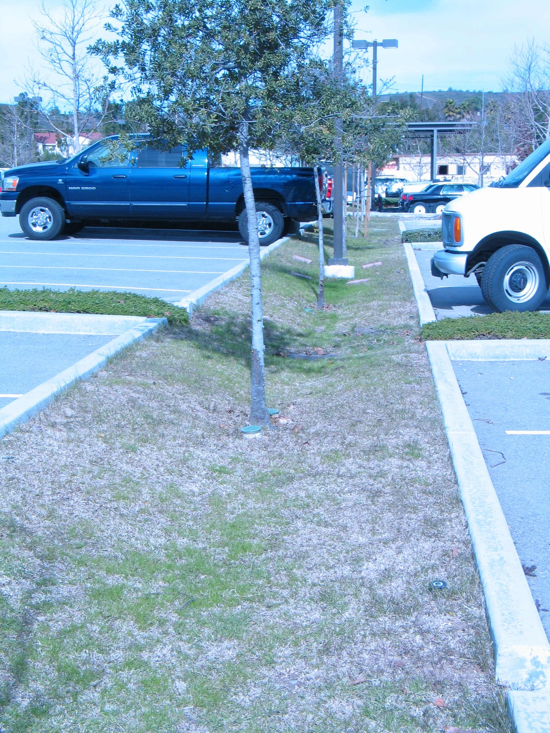

Slide 9
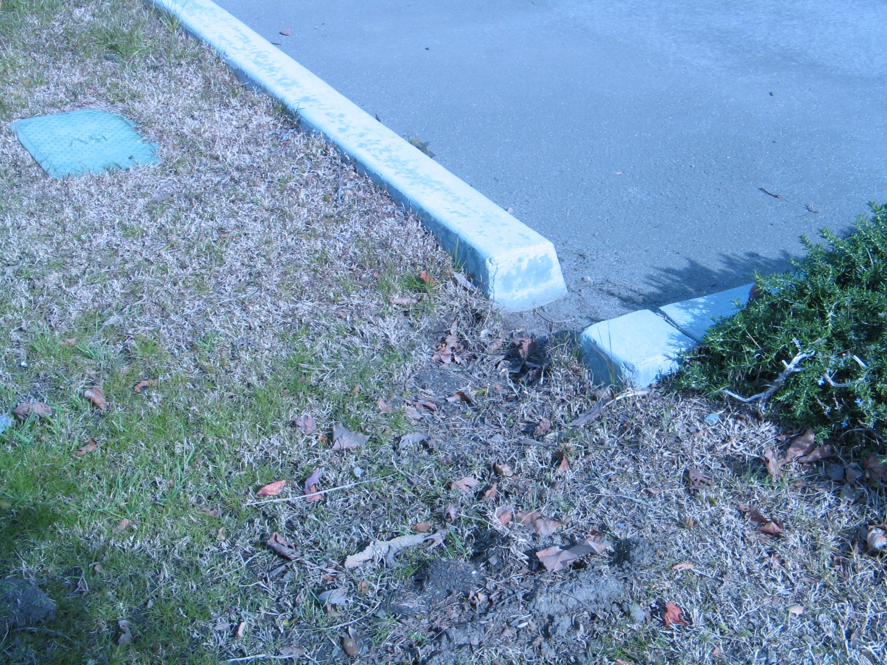

Slide 10
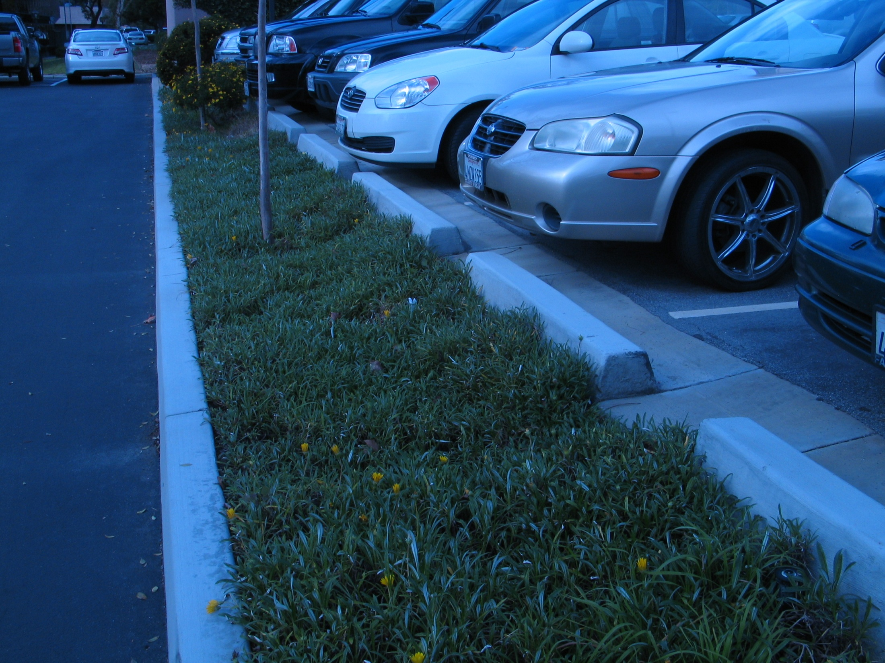

Slide 11
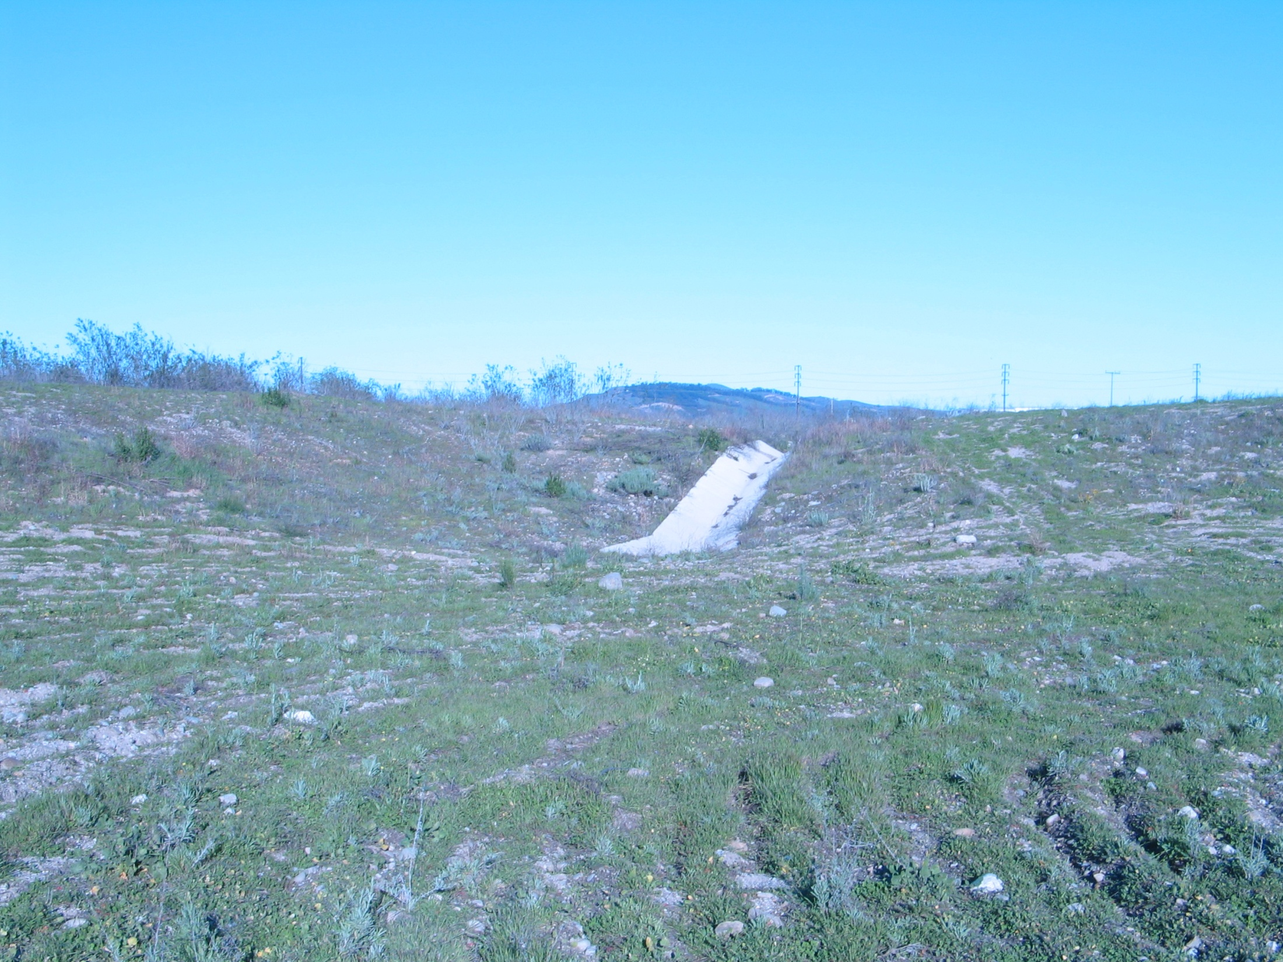

Slide 12
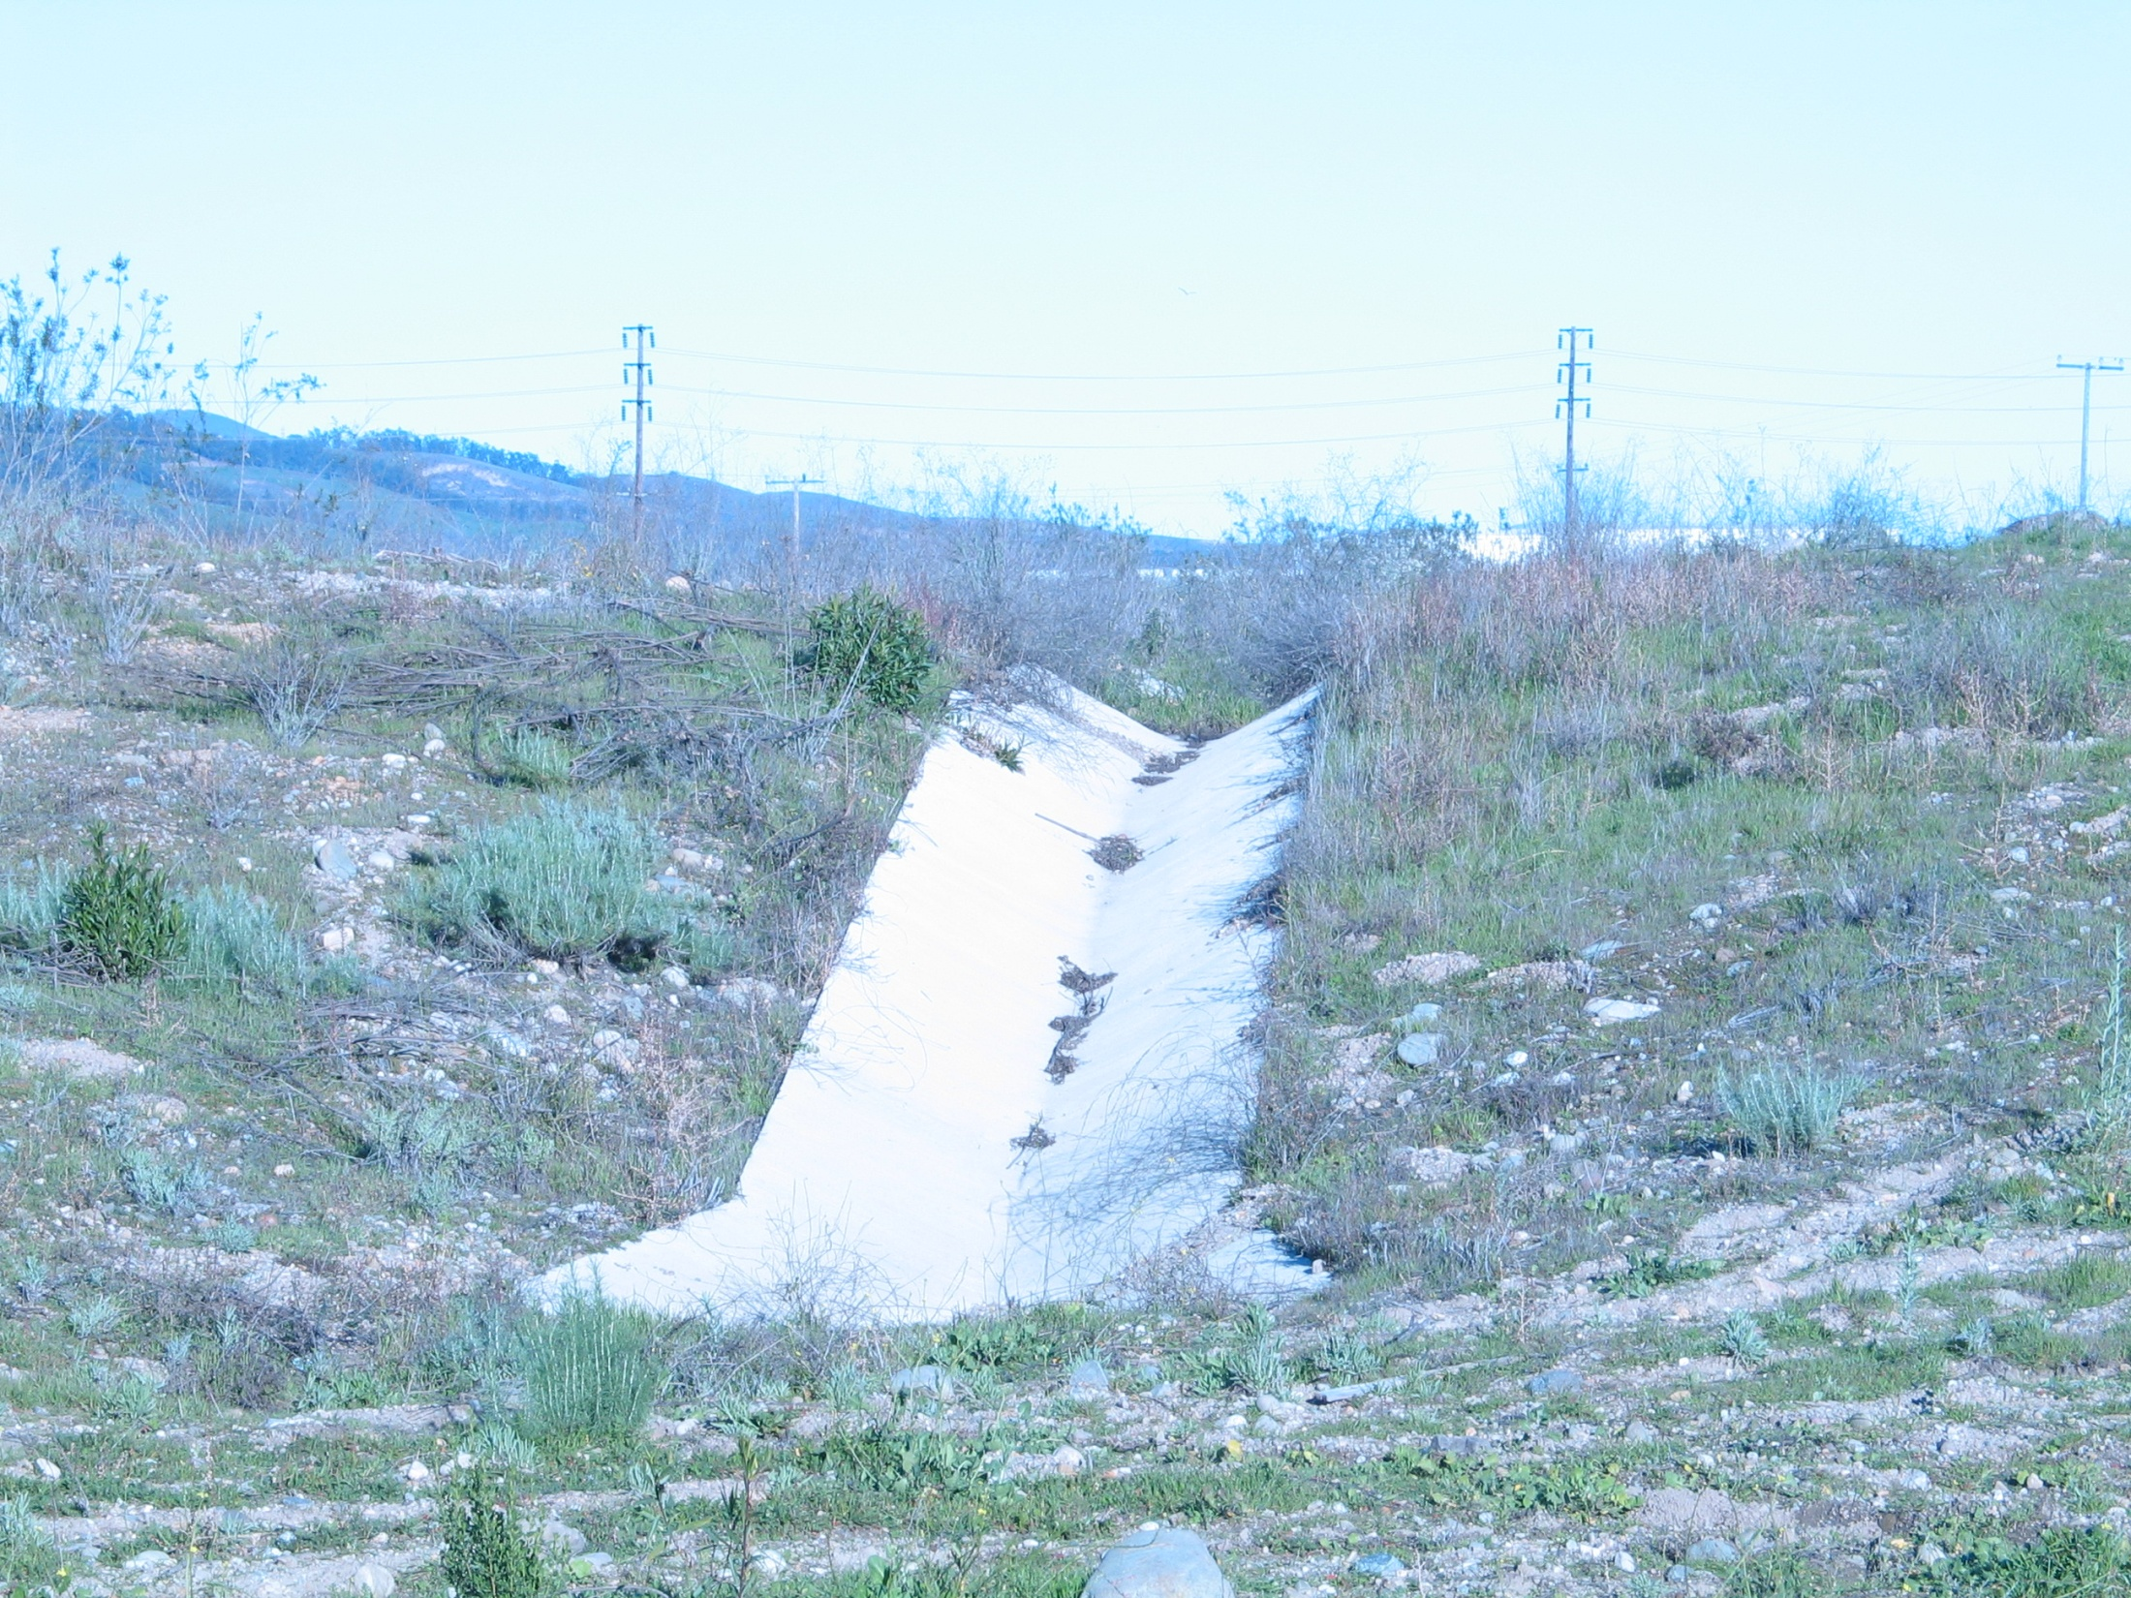

Slide 13
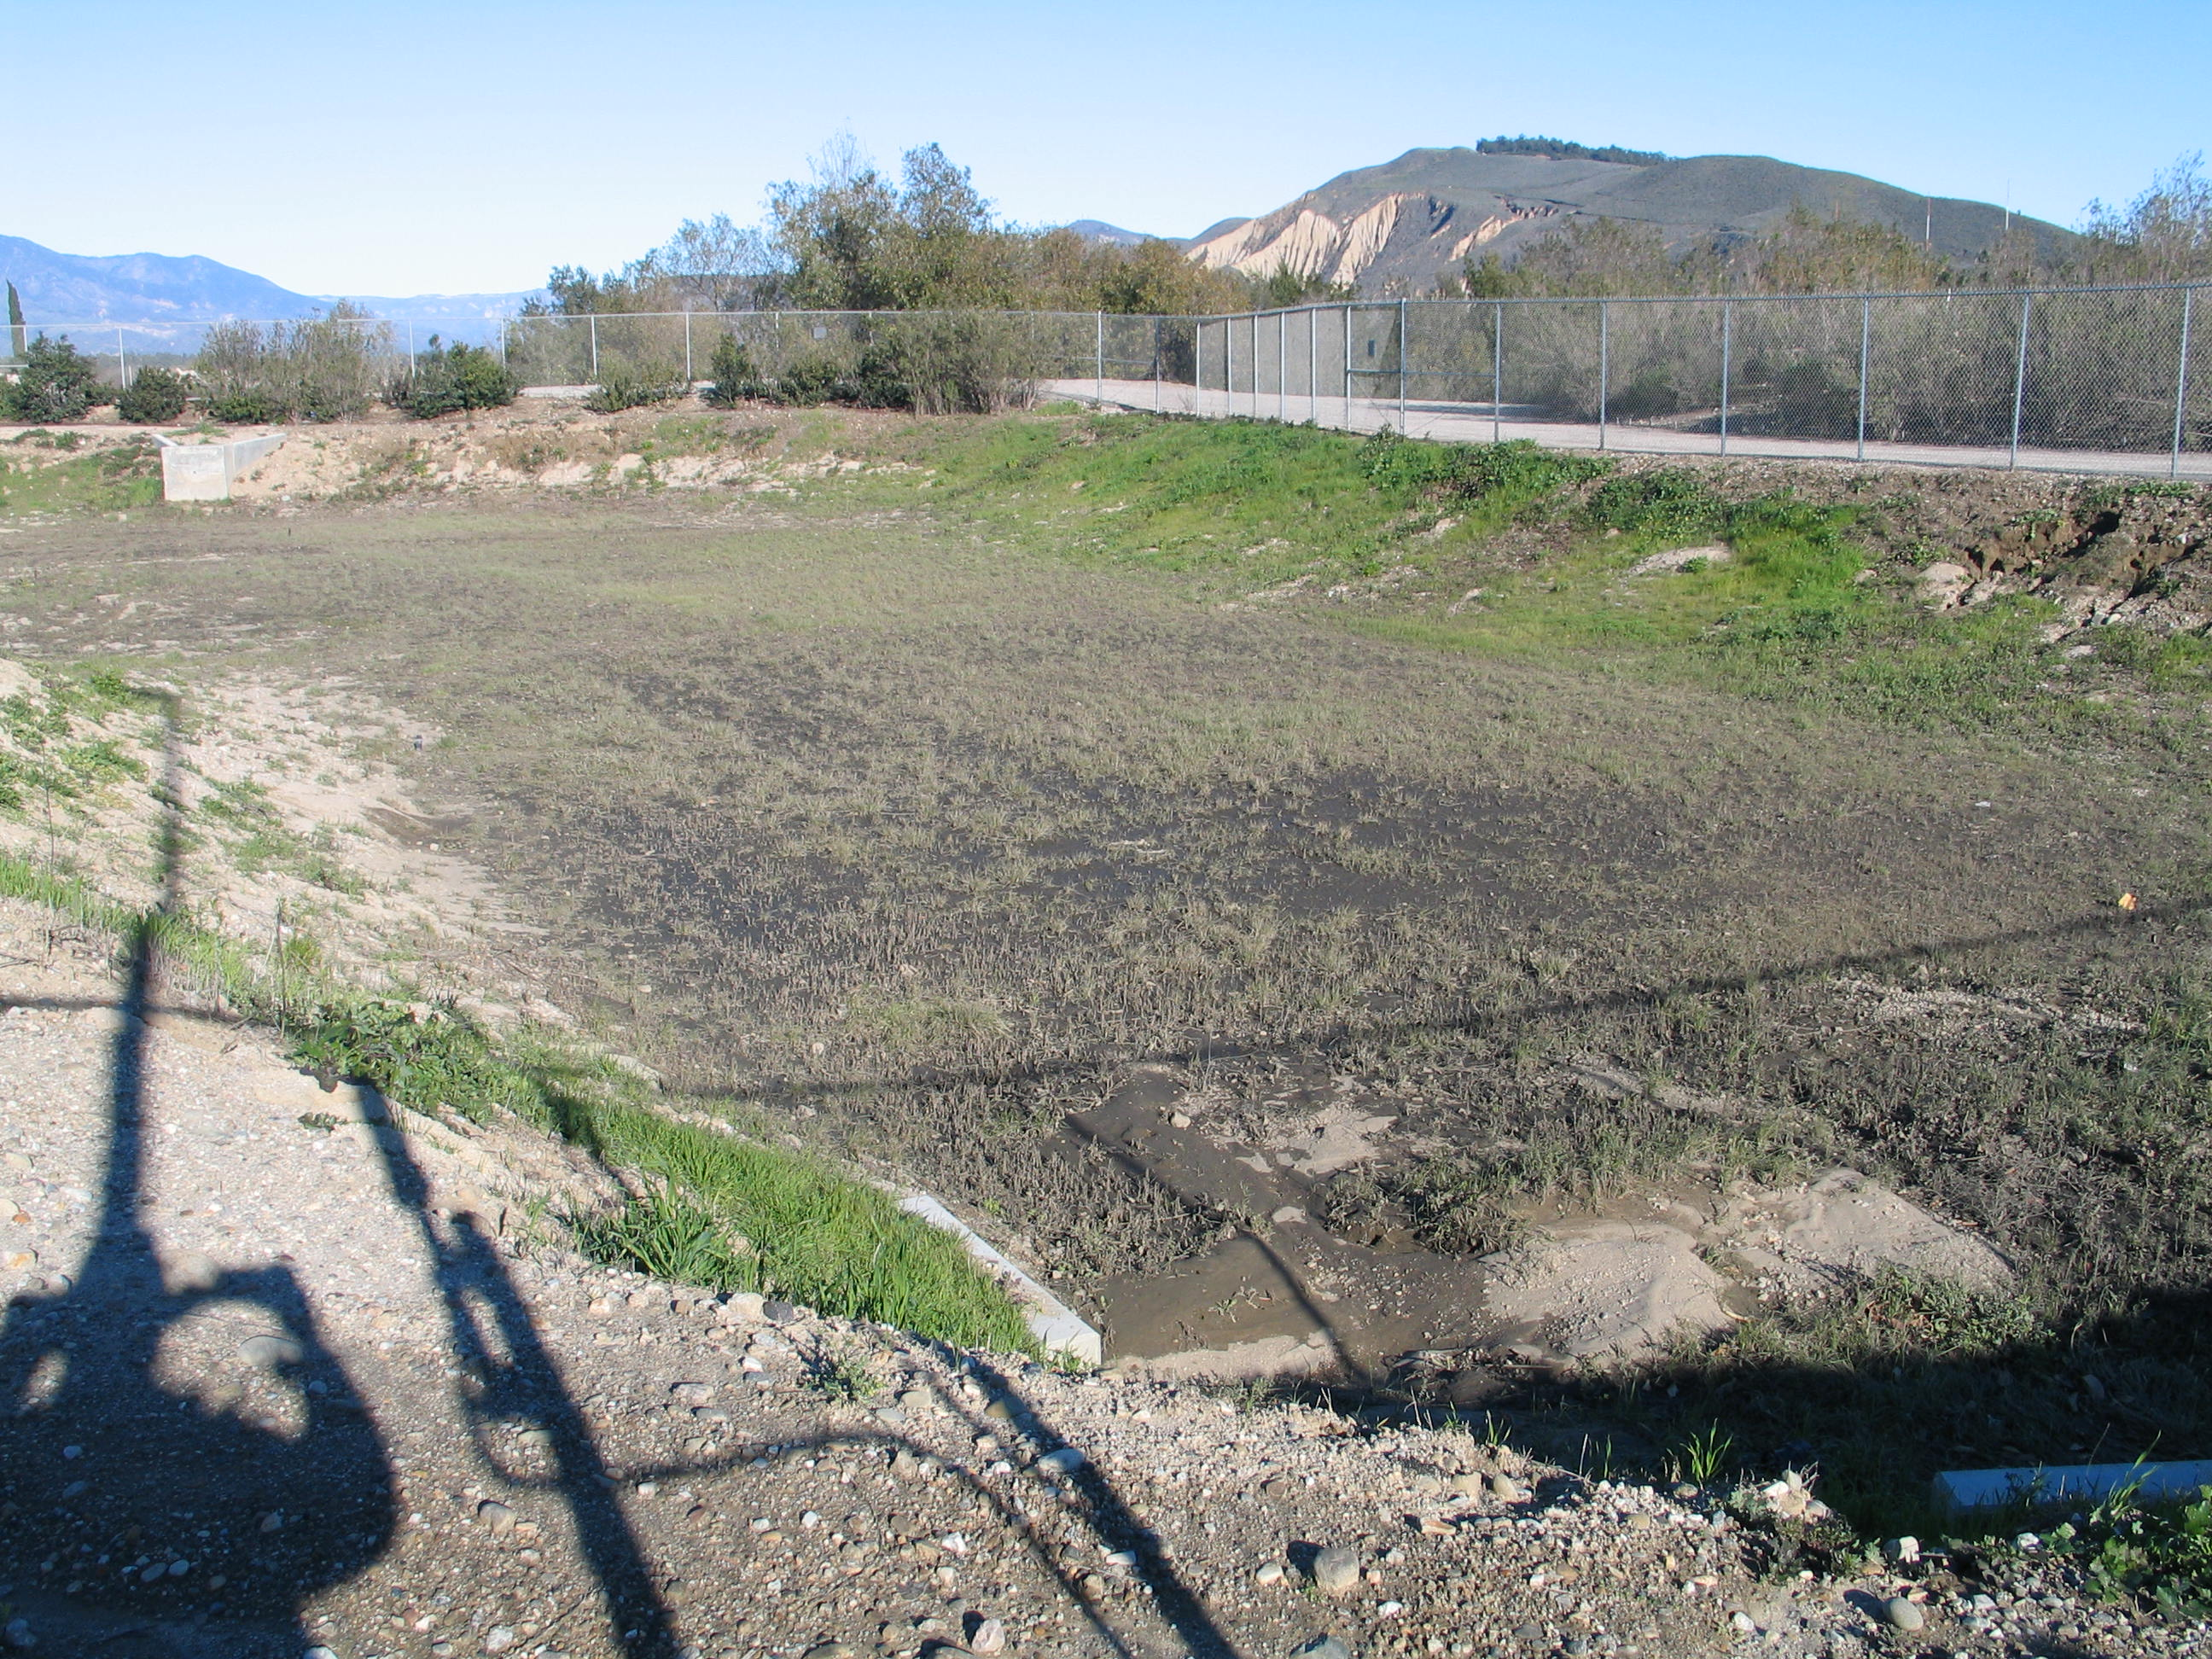

Slide 14
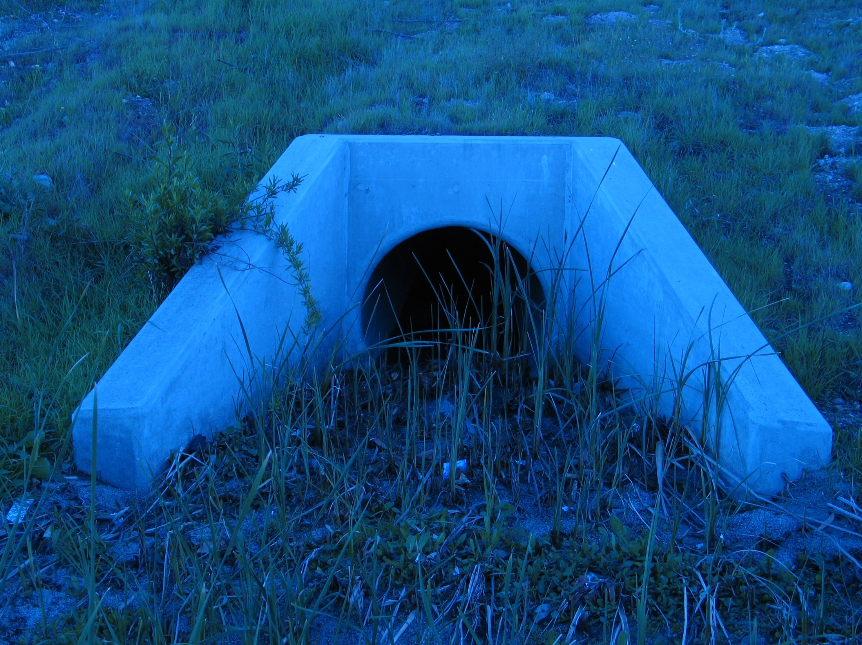

Slide 15
Trash Management at Public Events
Permit Process – Identify and mitigate
Permittees are asked to review a fact sheet on Storm water protection and acknowledge that they will comply BMPs
Special events Coordinator and Grounds Supervisor Training

Slide 16
Installation, Clean-up and Maintenance of County Receptacles.
Government Center – daily inspection and clean-up of trash and debris
Offsite-contractor inspection and clean-up on a weekly basis
Annual training of all key contractor personnel

Slide 17
Street Sweeping
Dry Sweeping Only
Vendors required to maintain clean equipment in good working order
Vendors are required to provide quarterly reports on Street miles swept and volume of debris collected
Report any evidence of debris buildup or others issues that may effect runoff
Future contracts may require more technologically advanced sweepers

Slide 18
Power Washing
Remove large debris prior to washing
Use steam instead of detergents
Direct Spray away from drains and storm water systems whenever possible.
Direct wash water into planters, lawns etc. in order to minimize the amount of water that goes into the storm system

Slide 19
Equipment Washing
Commercial Car Wash
Area designed to contain, collect filtrate or dispose of the wash water
Minimize the use of detergents, use detergents that are environmentally friendly

Slide 20
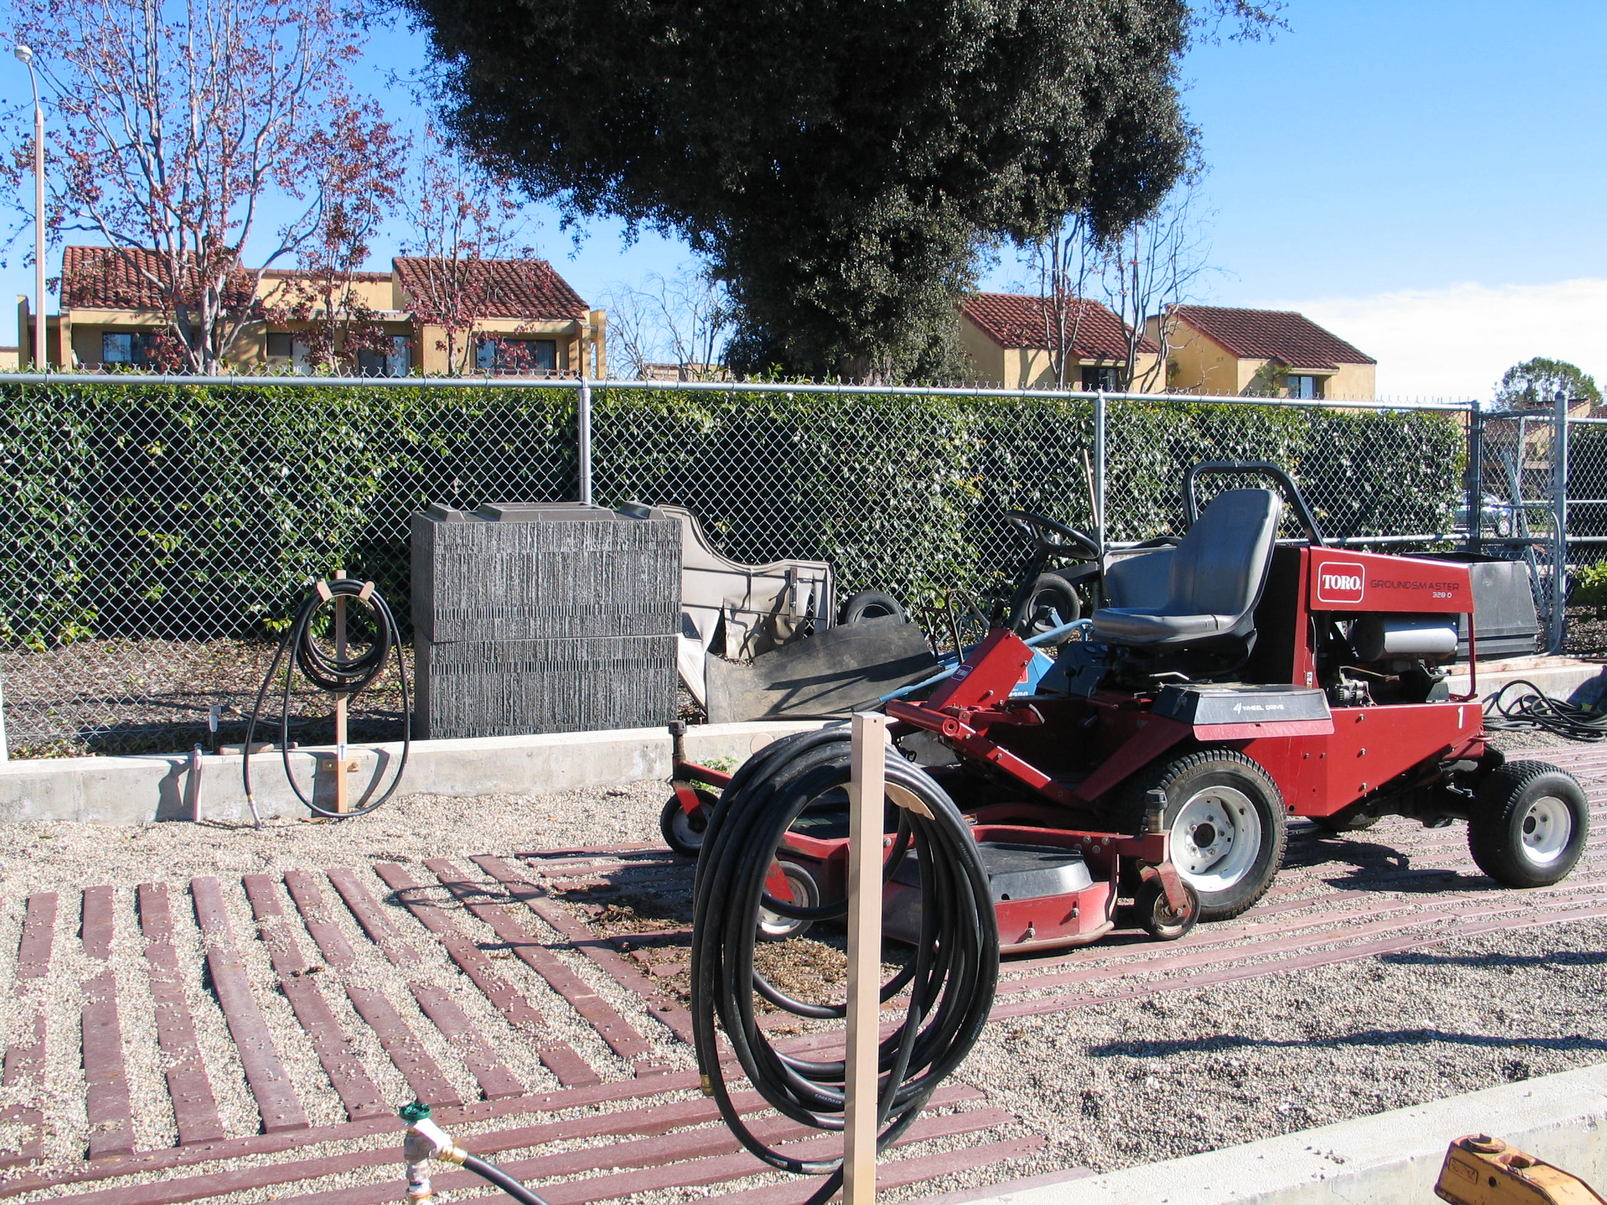

Slide 21
Landscape Construction
Soil is a carrier of various chemicals
Contain Storm Water and sediment on site
Slow velocity and splash effect
New Construction Permits include erosion mitigating measures and the installation of permanent structures.

Slide 22
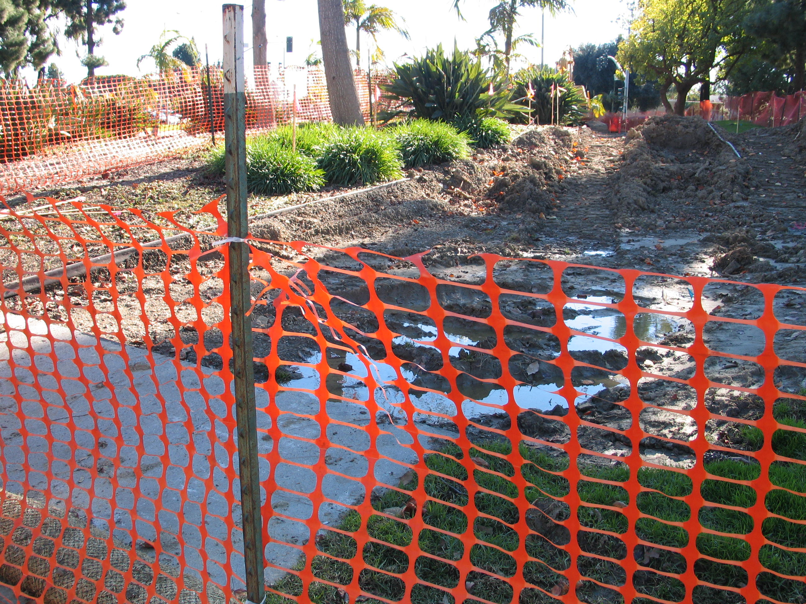

Slide 23
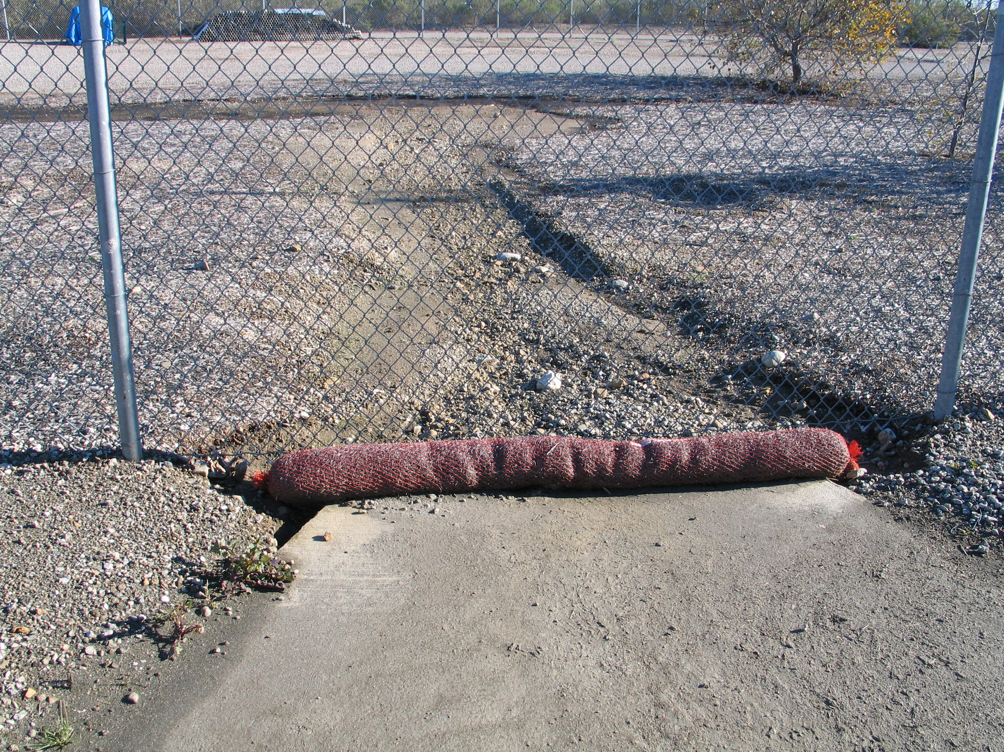

Slide 24
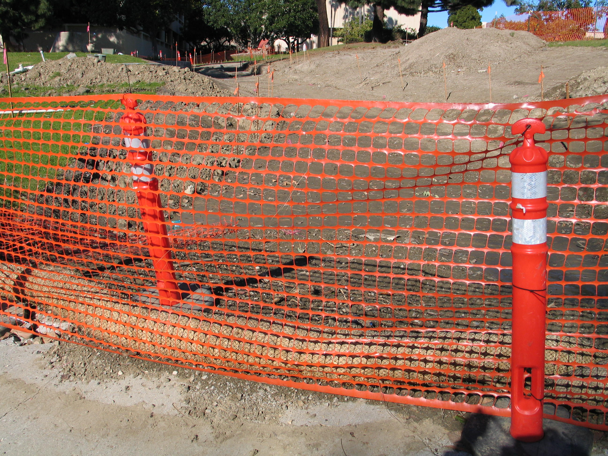

Slide 25
Get Out and Inspect Your Areas
Before a Rain Event
During a Rain Event
After a Rain Event

Slide 26
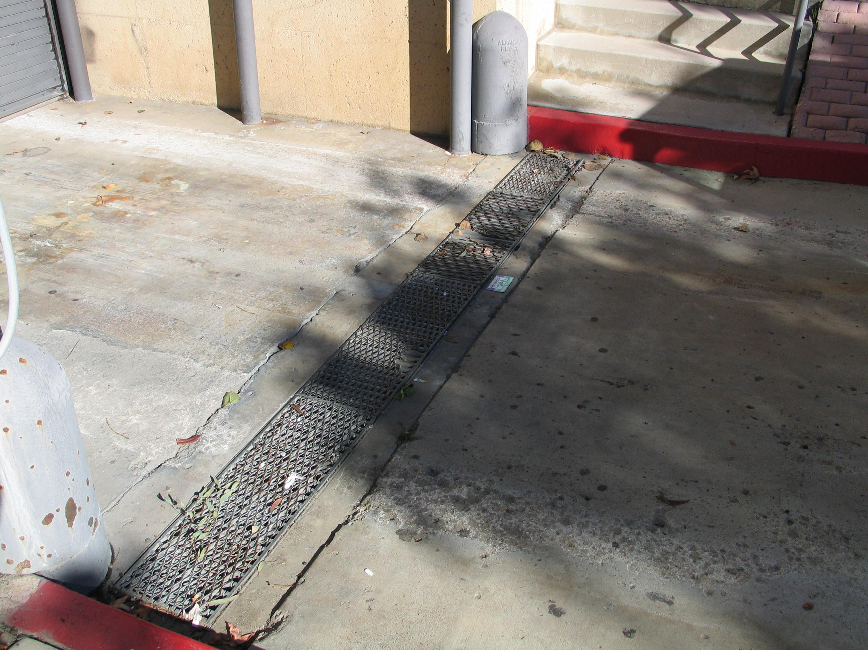

Slide 27
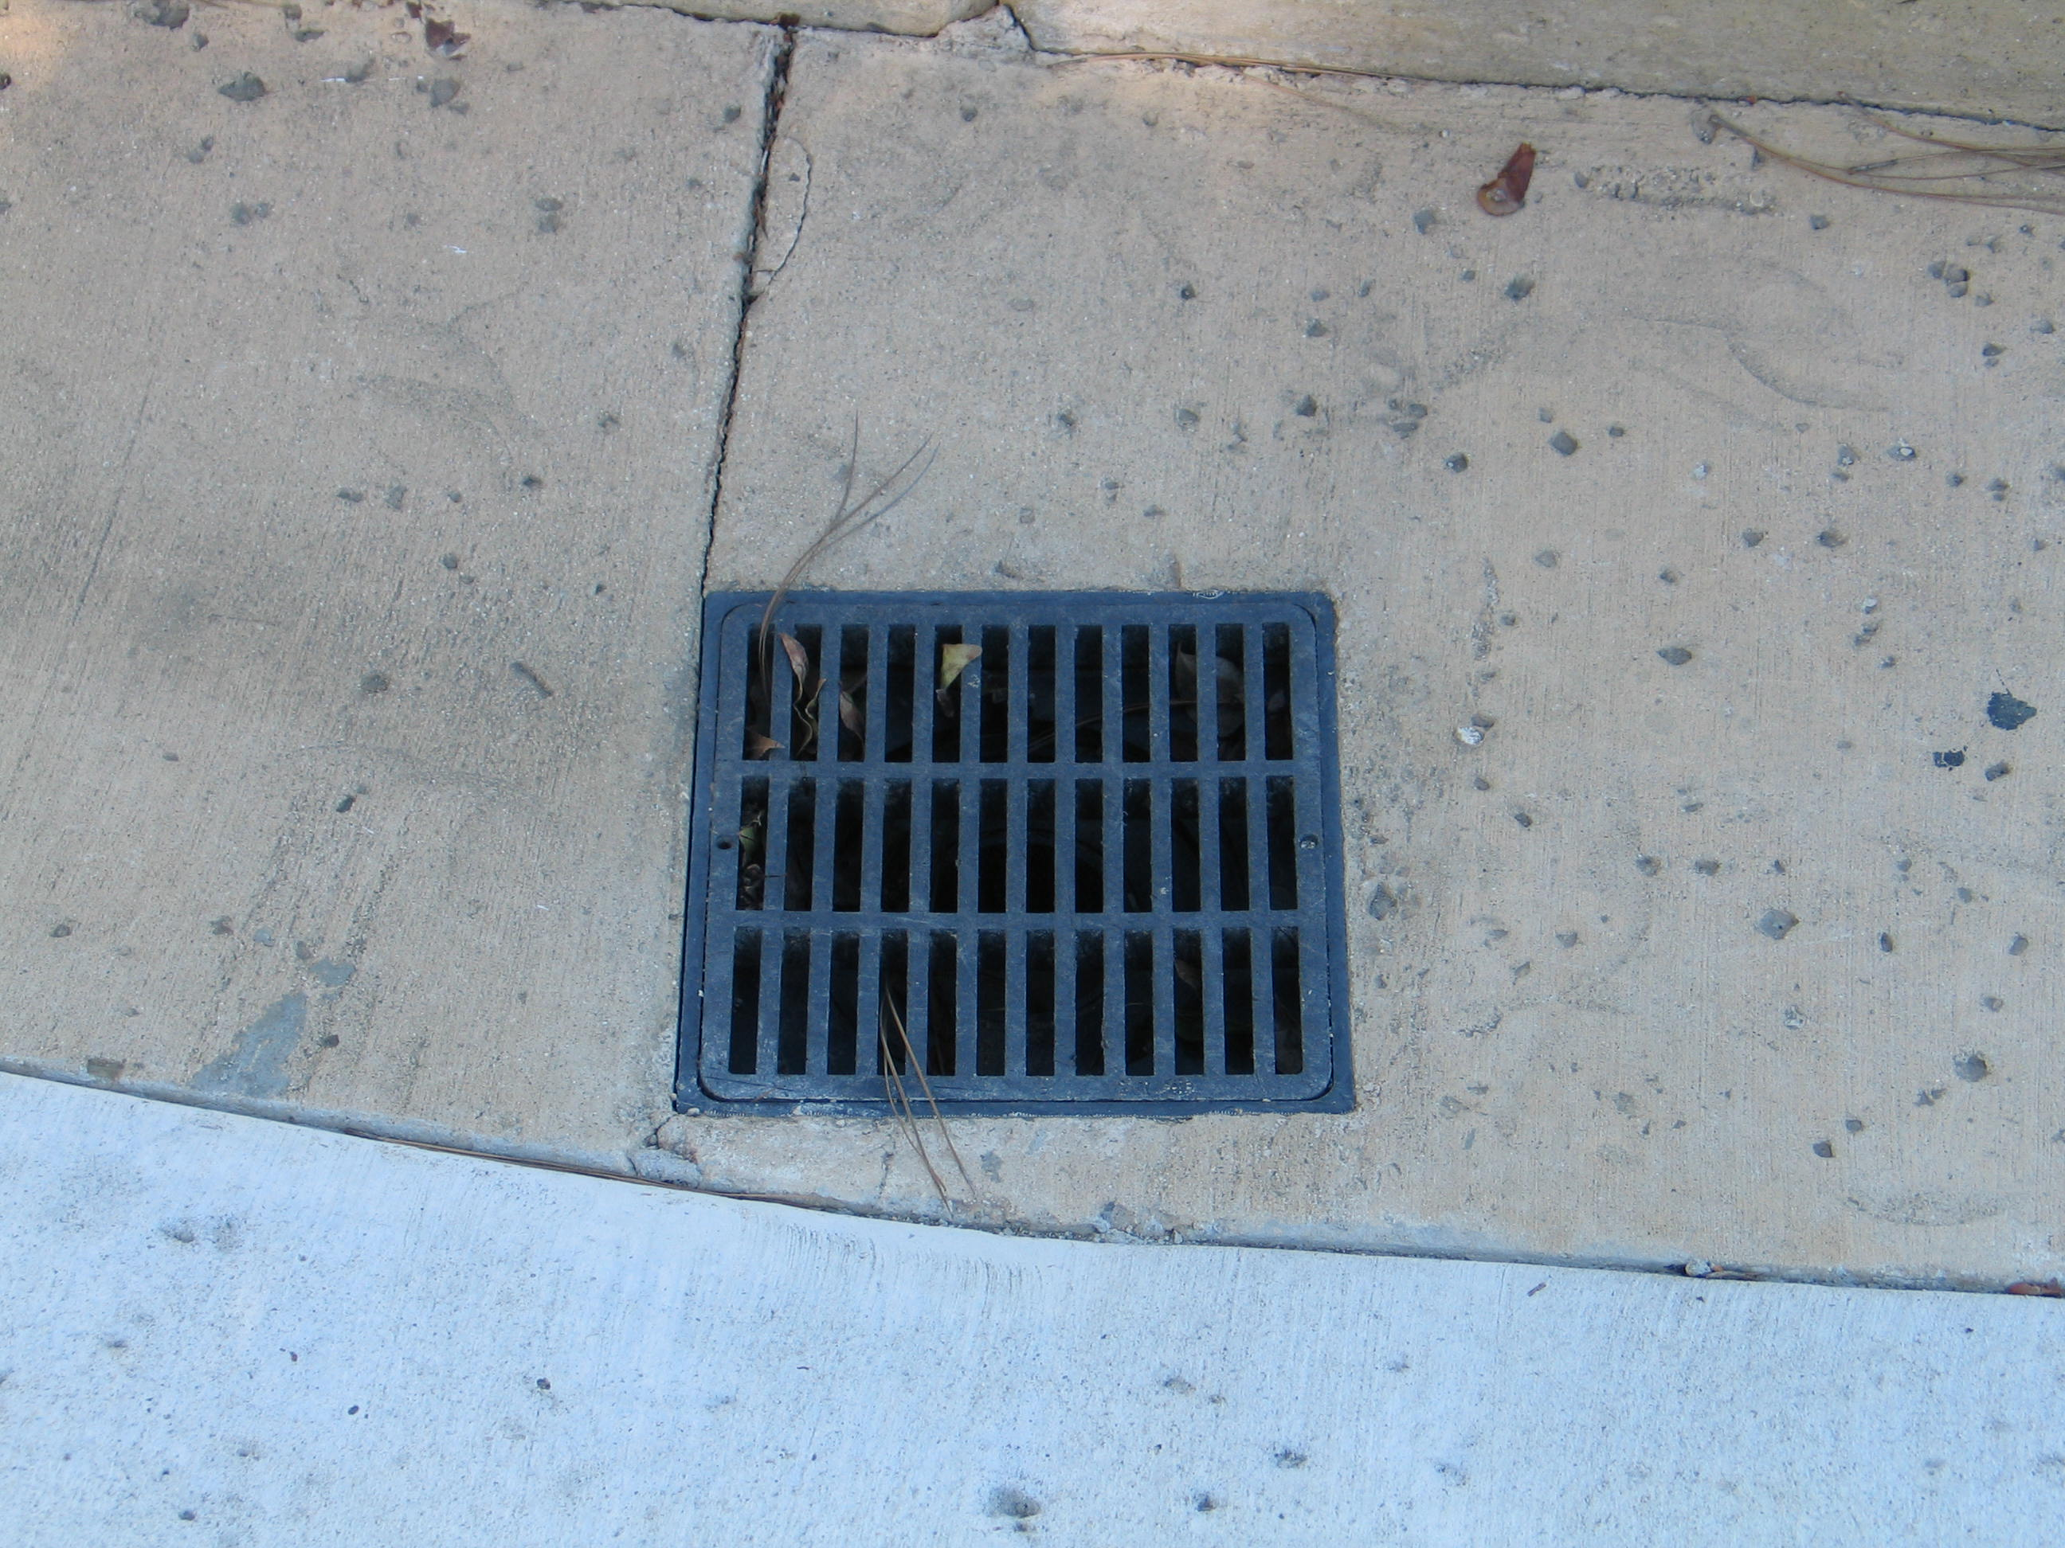

Slide 28
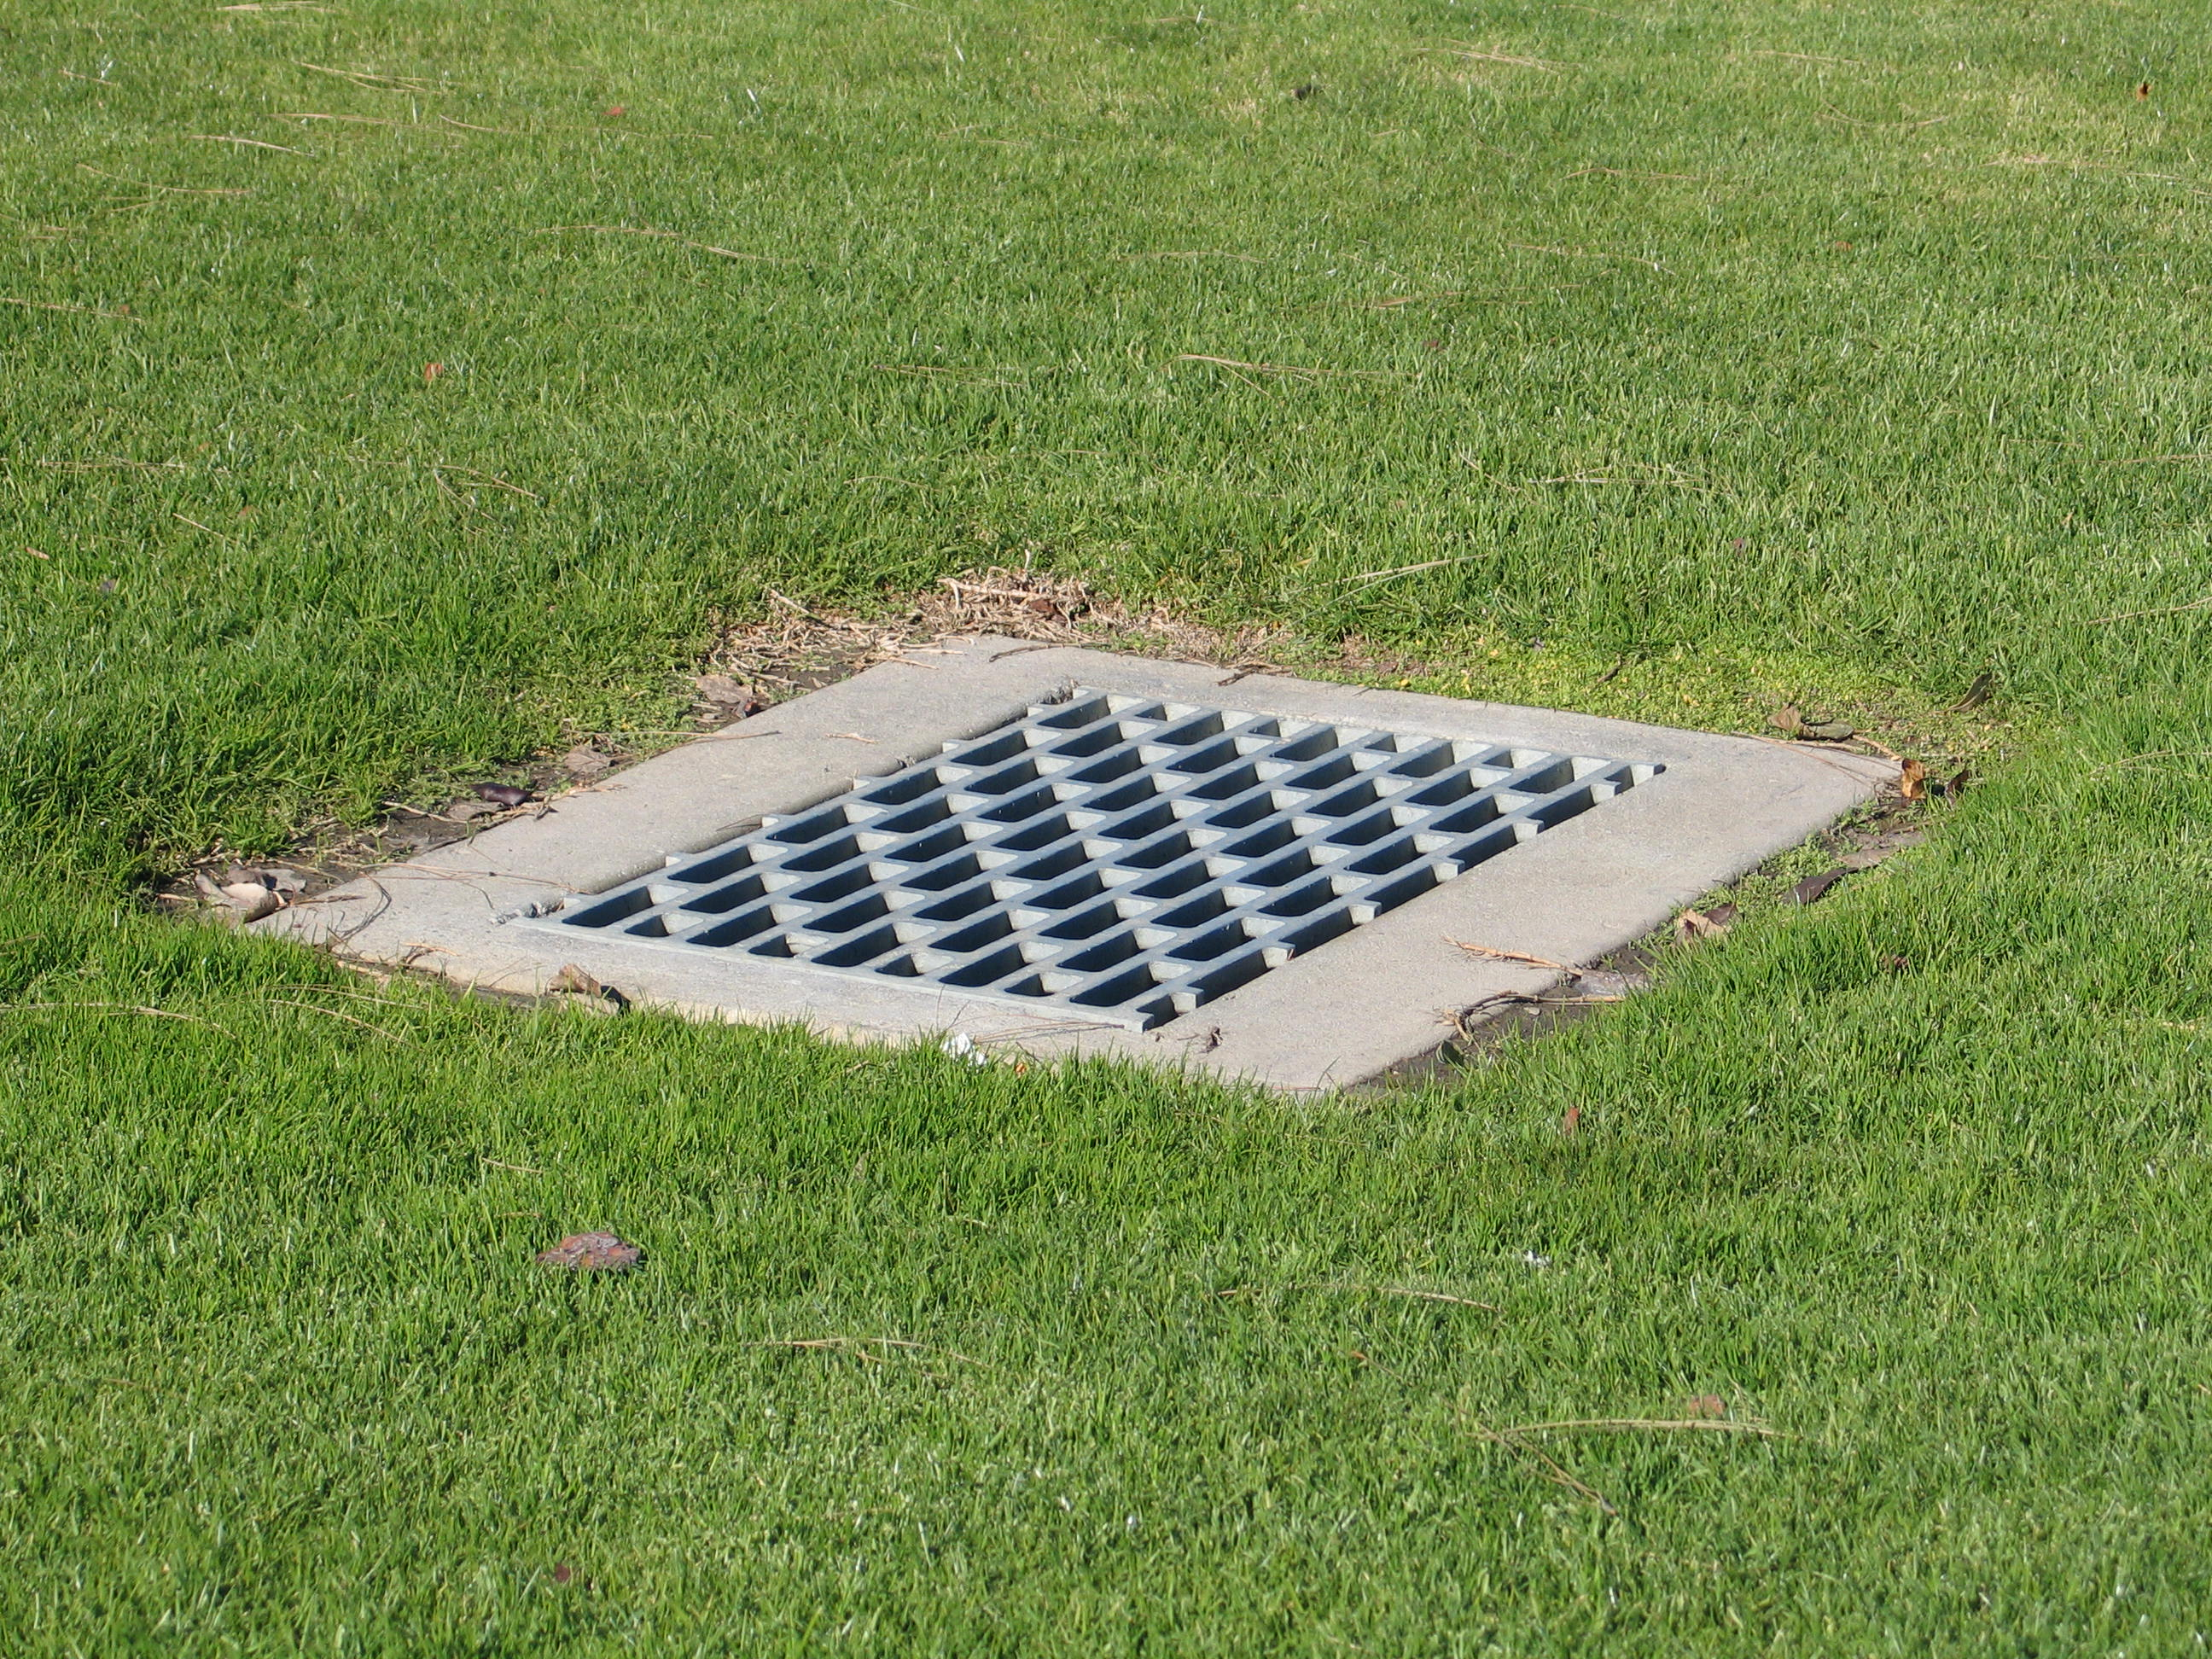

Slide 29
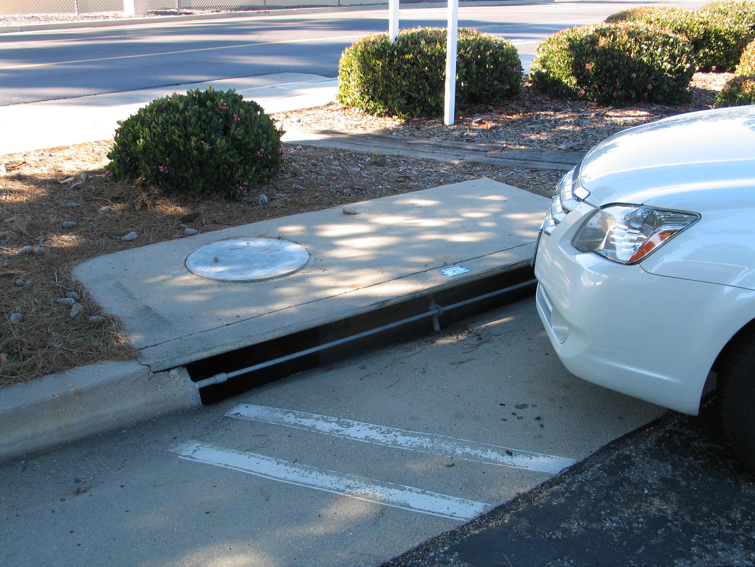

Slide 30
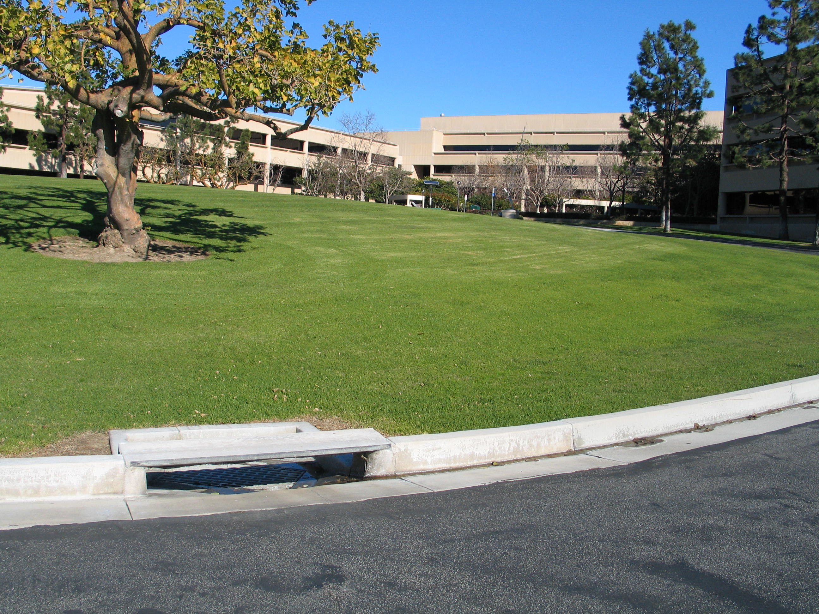

Slide 31
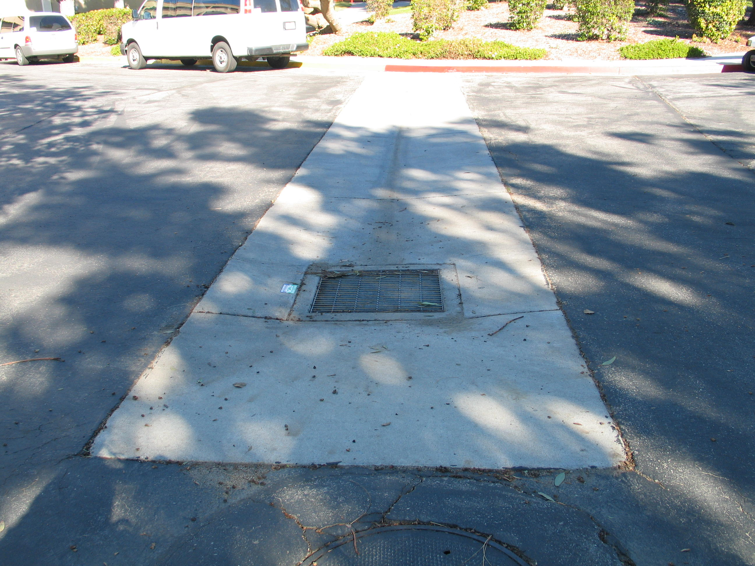

Slide 32
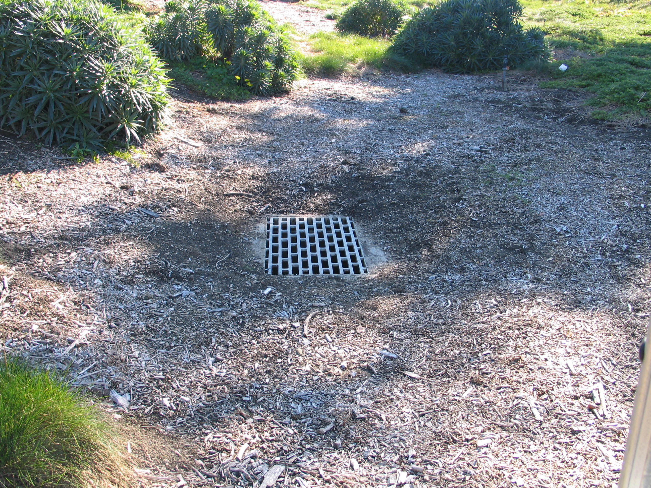

Slide 33
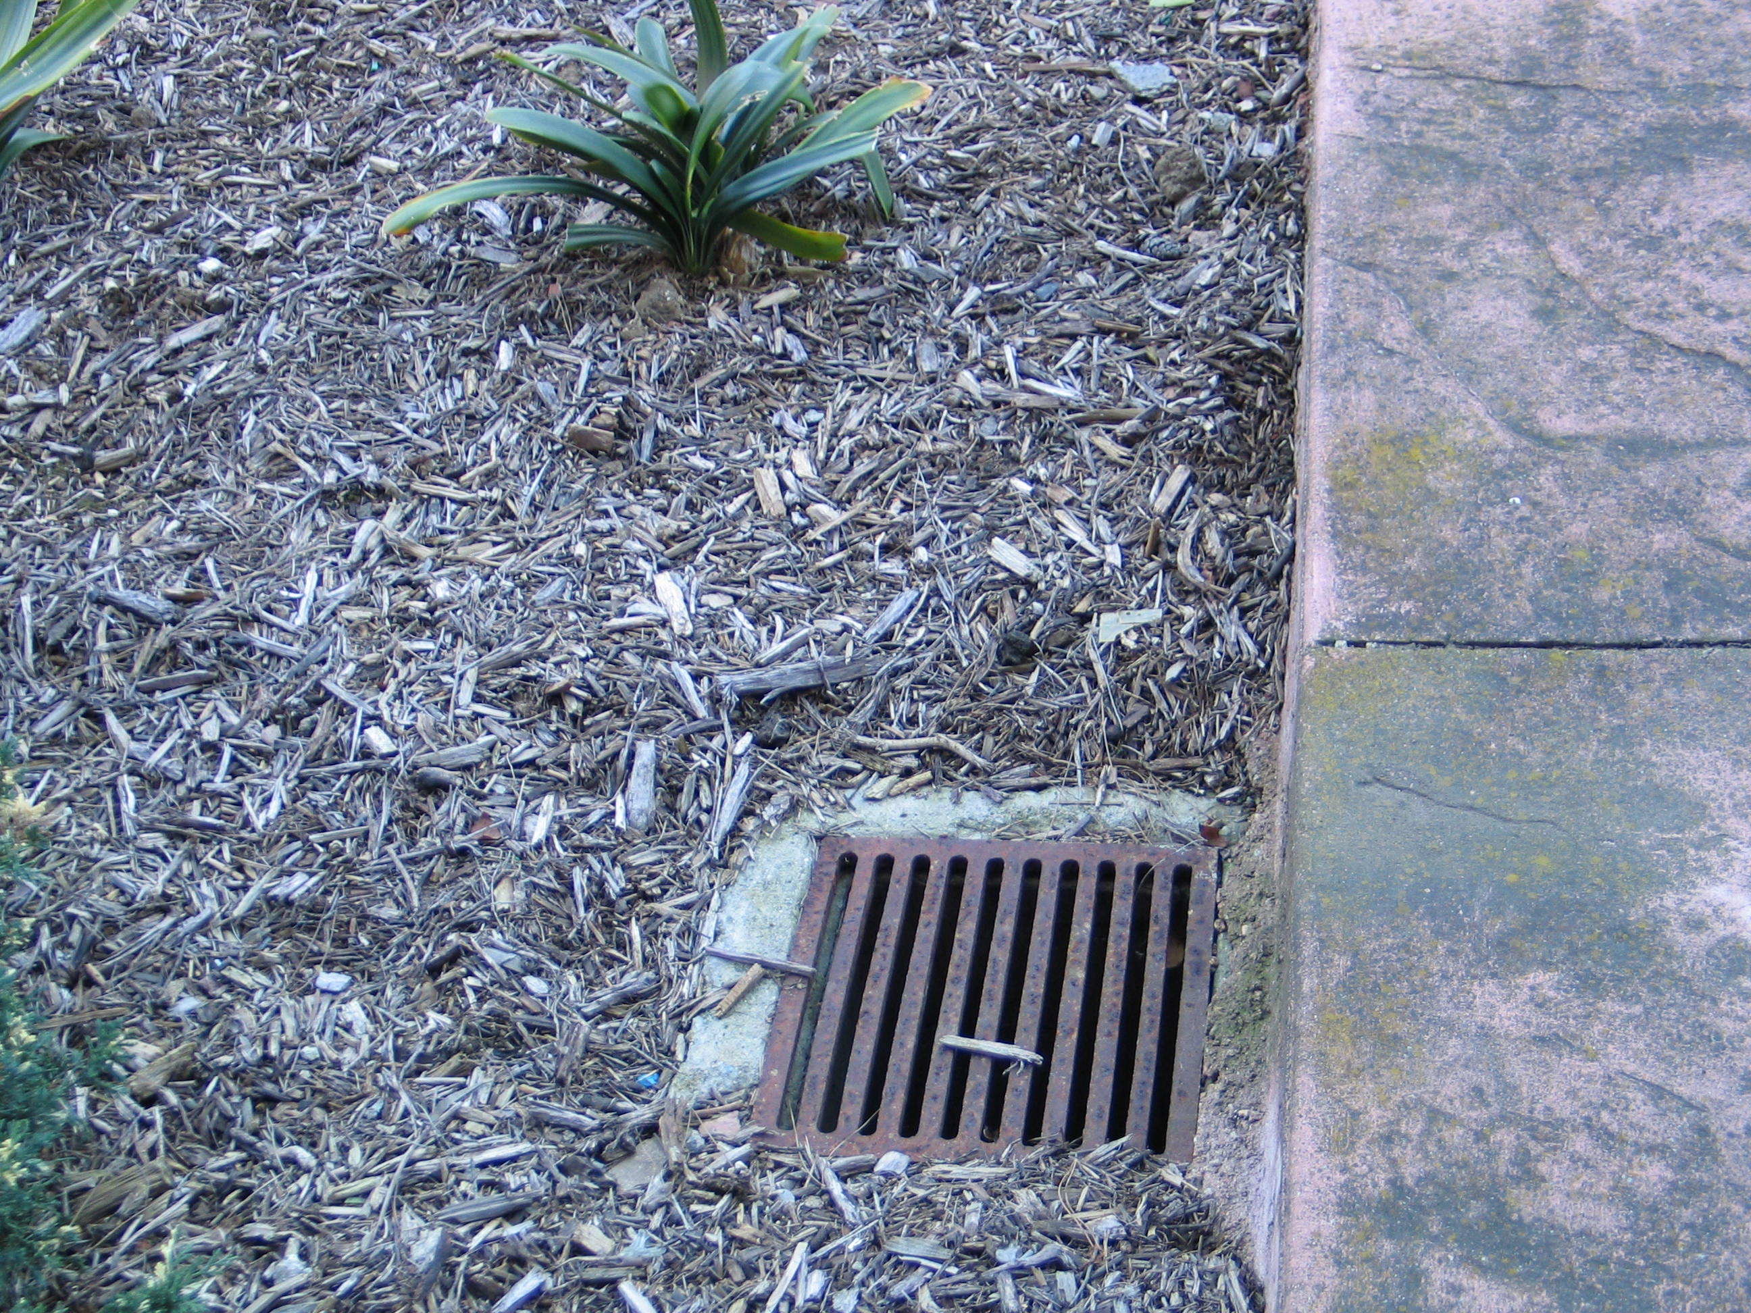

Slide 34
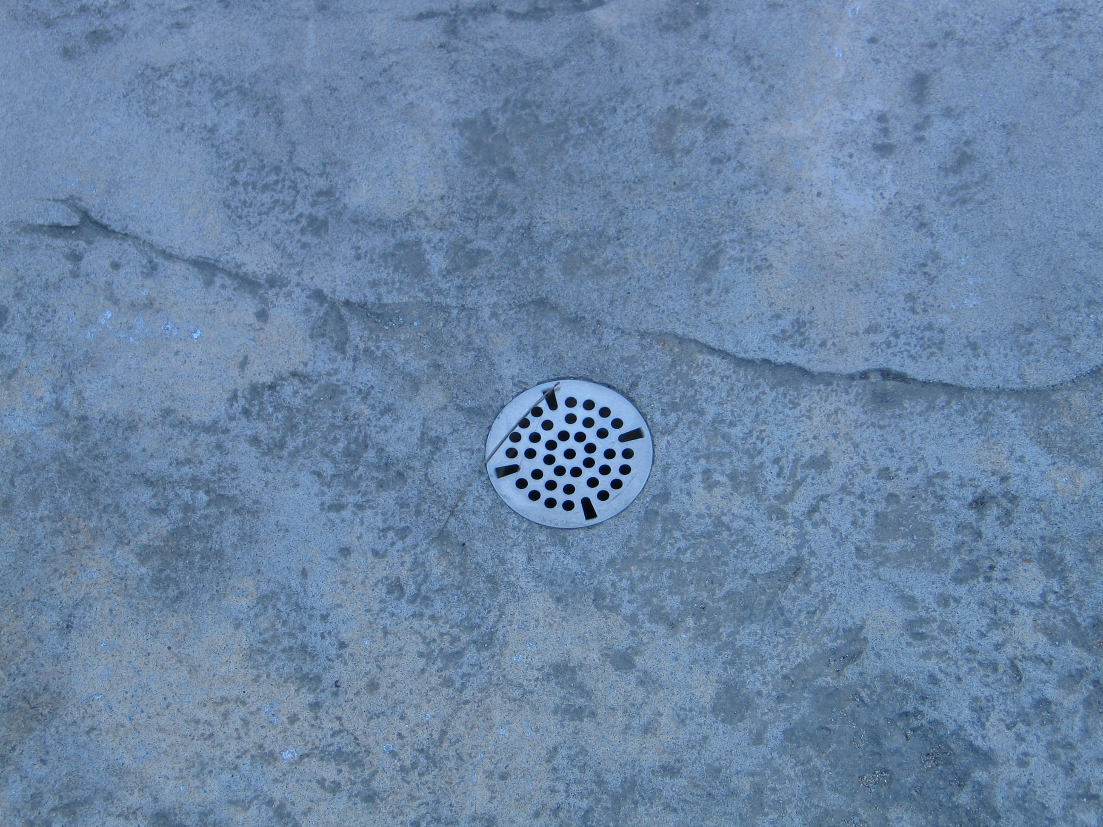

Slide 35
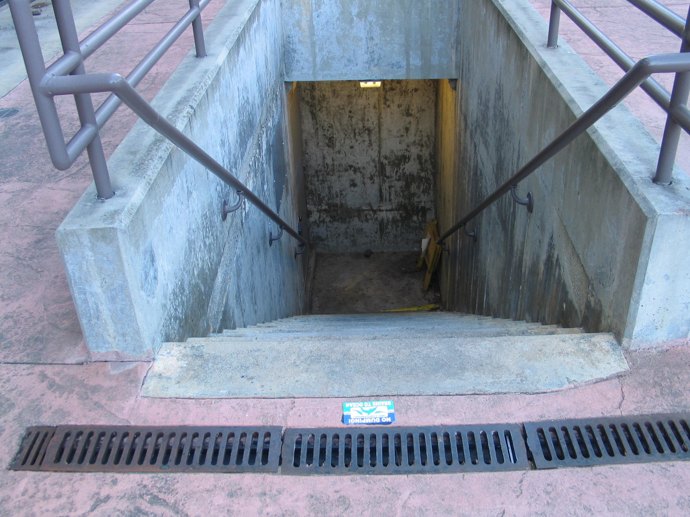

Slide 36
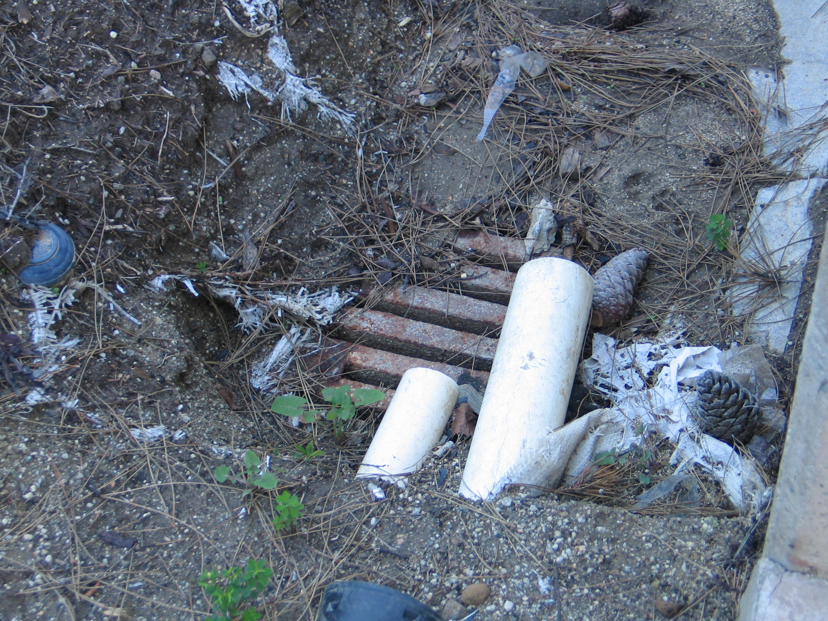

Slide 37
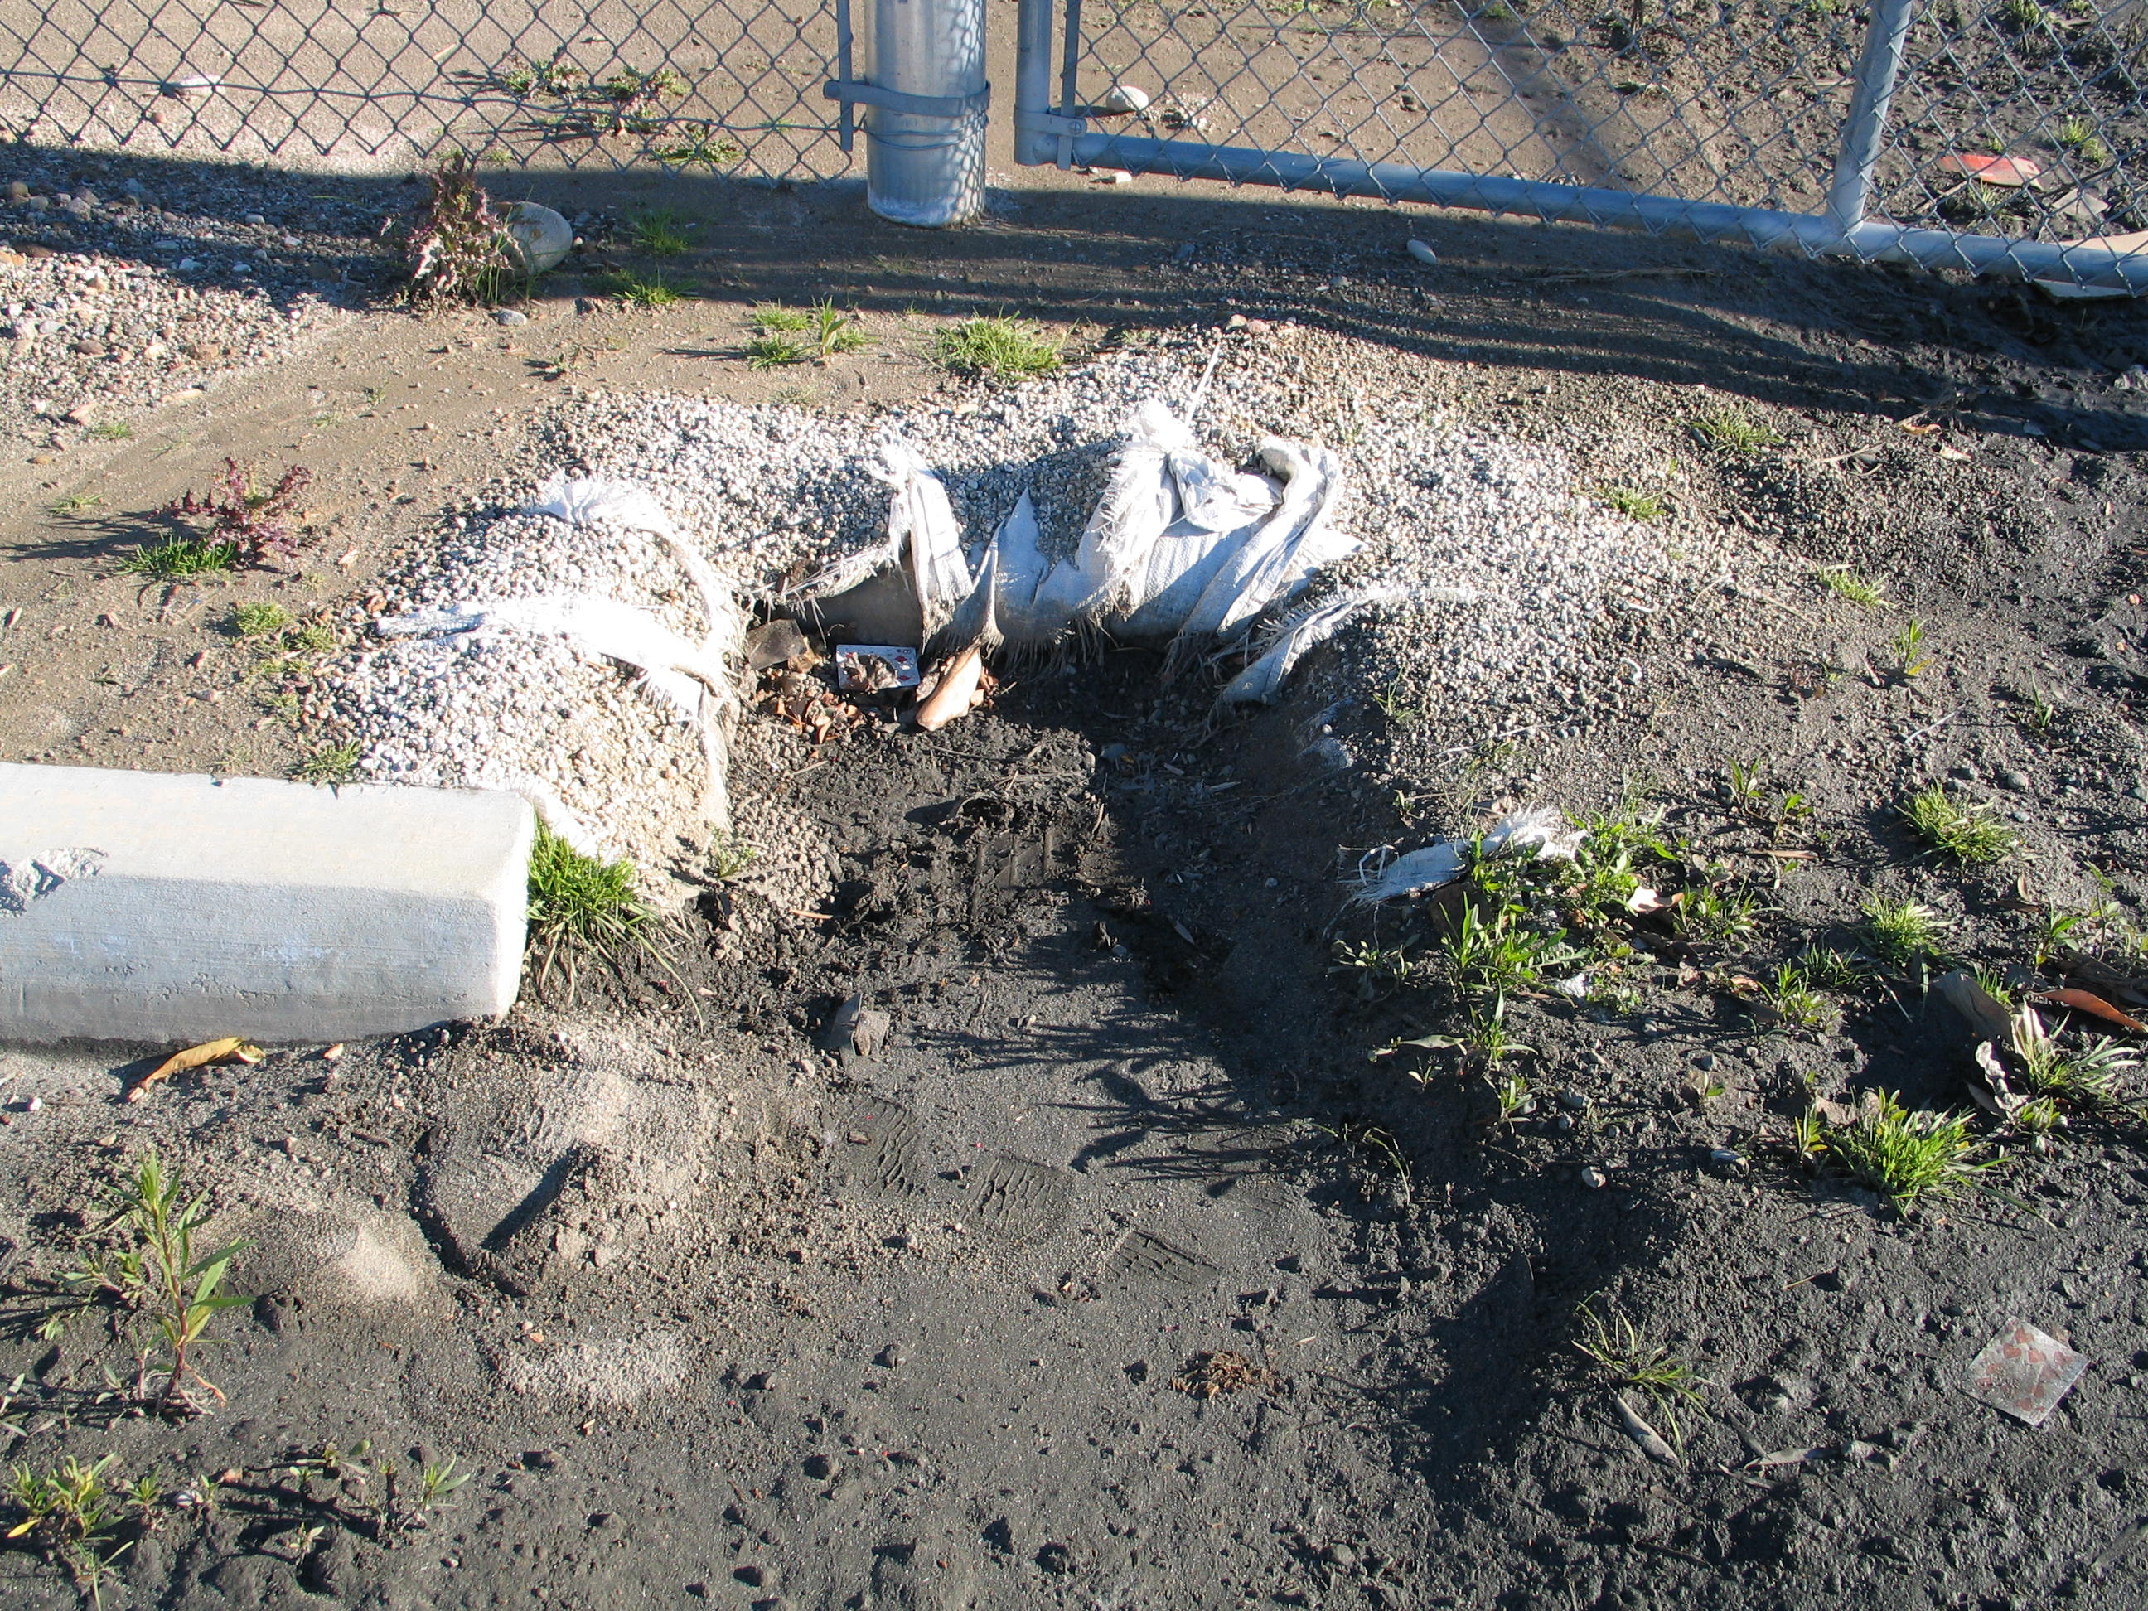

Slide 38
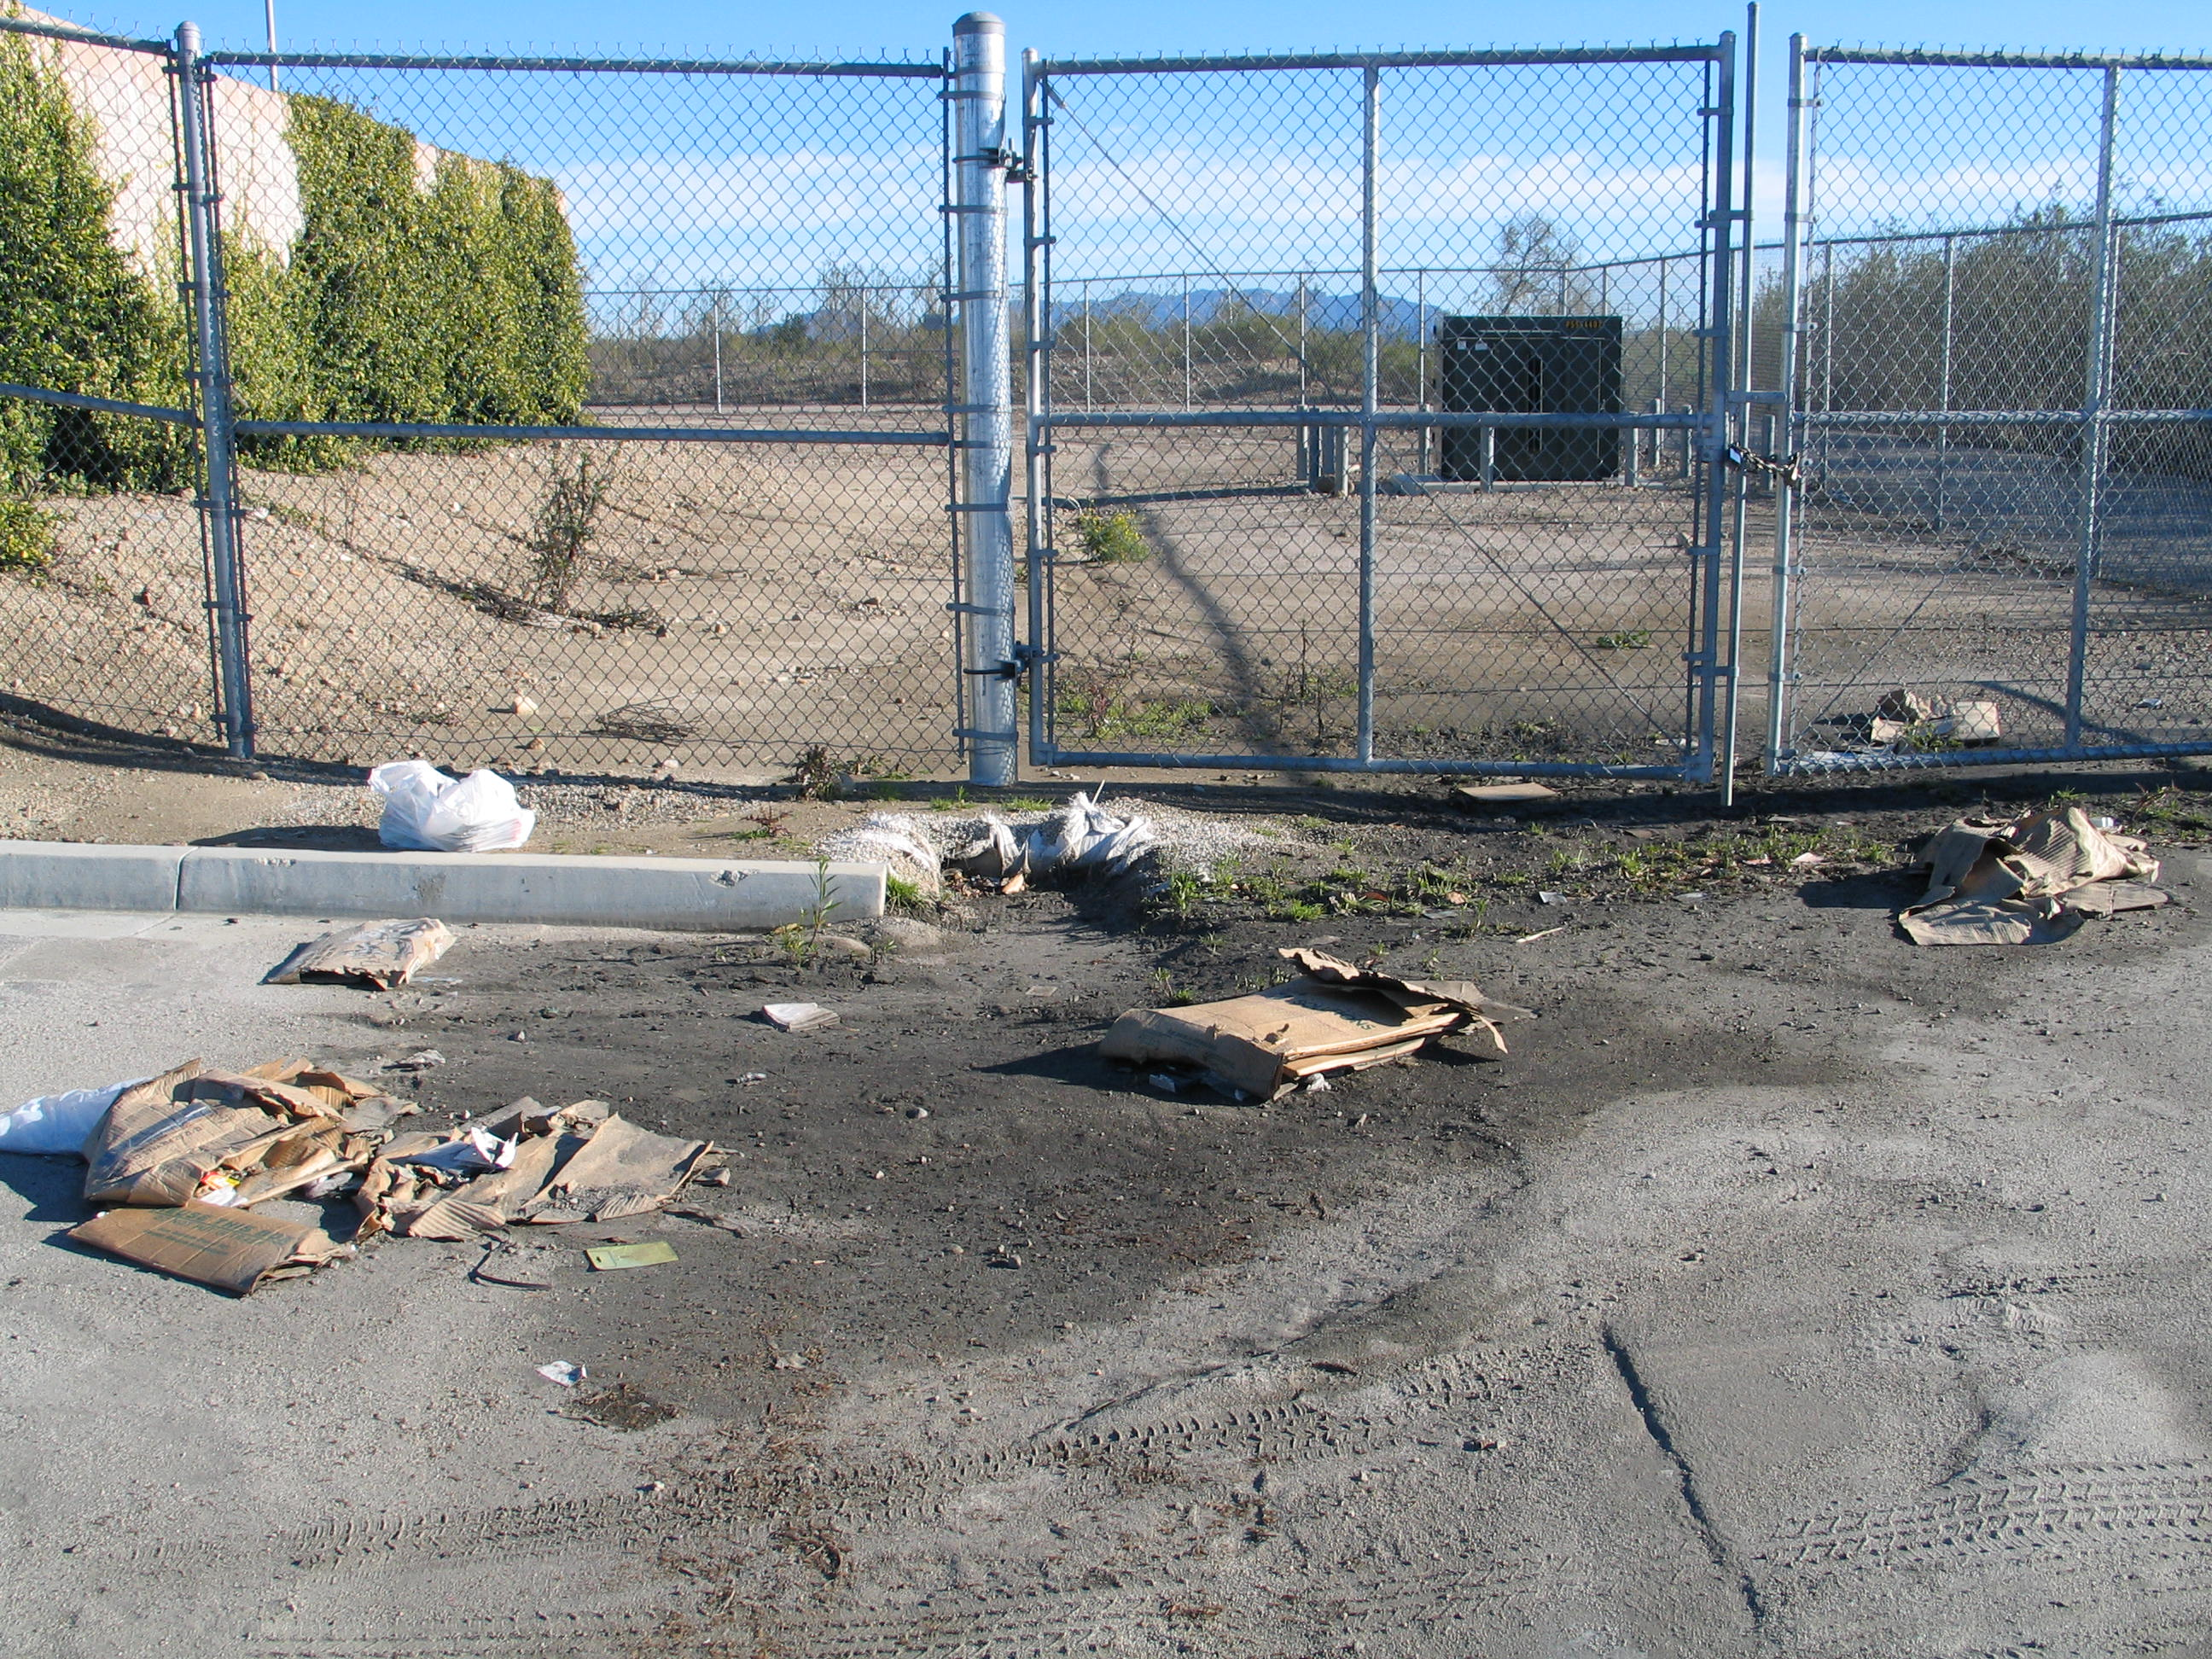

Slide 39
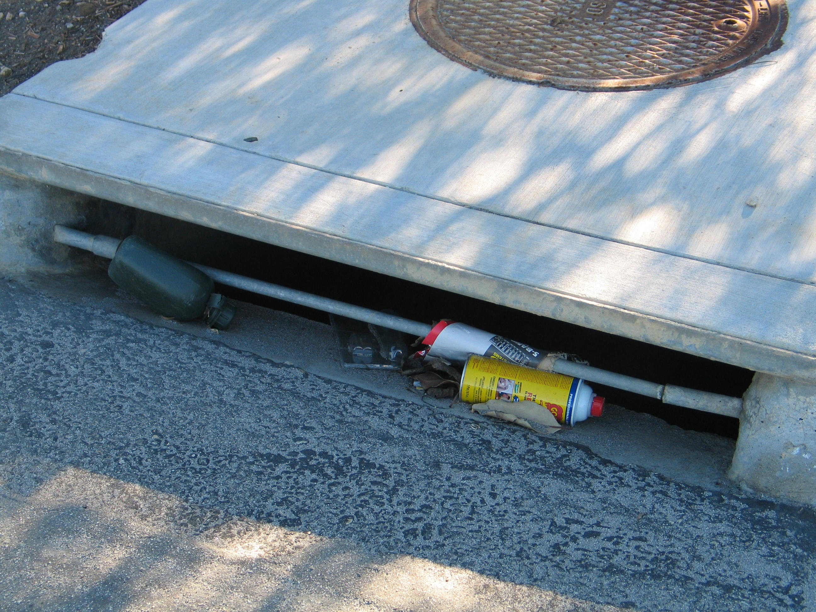

Slide 40
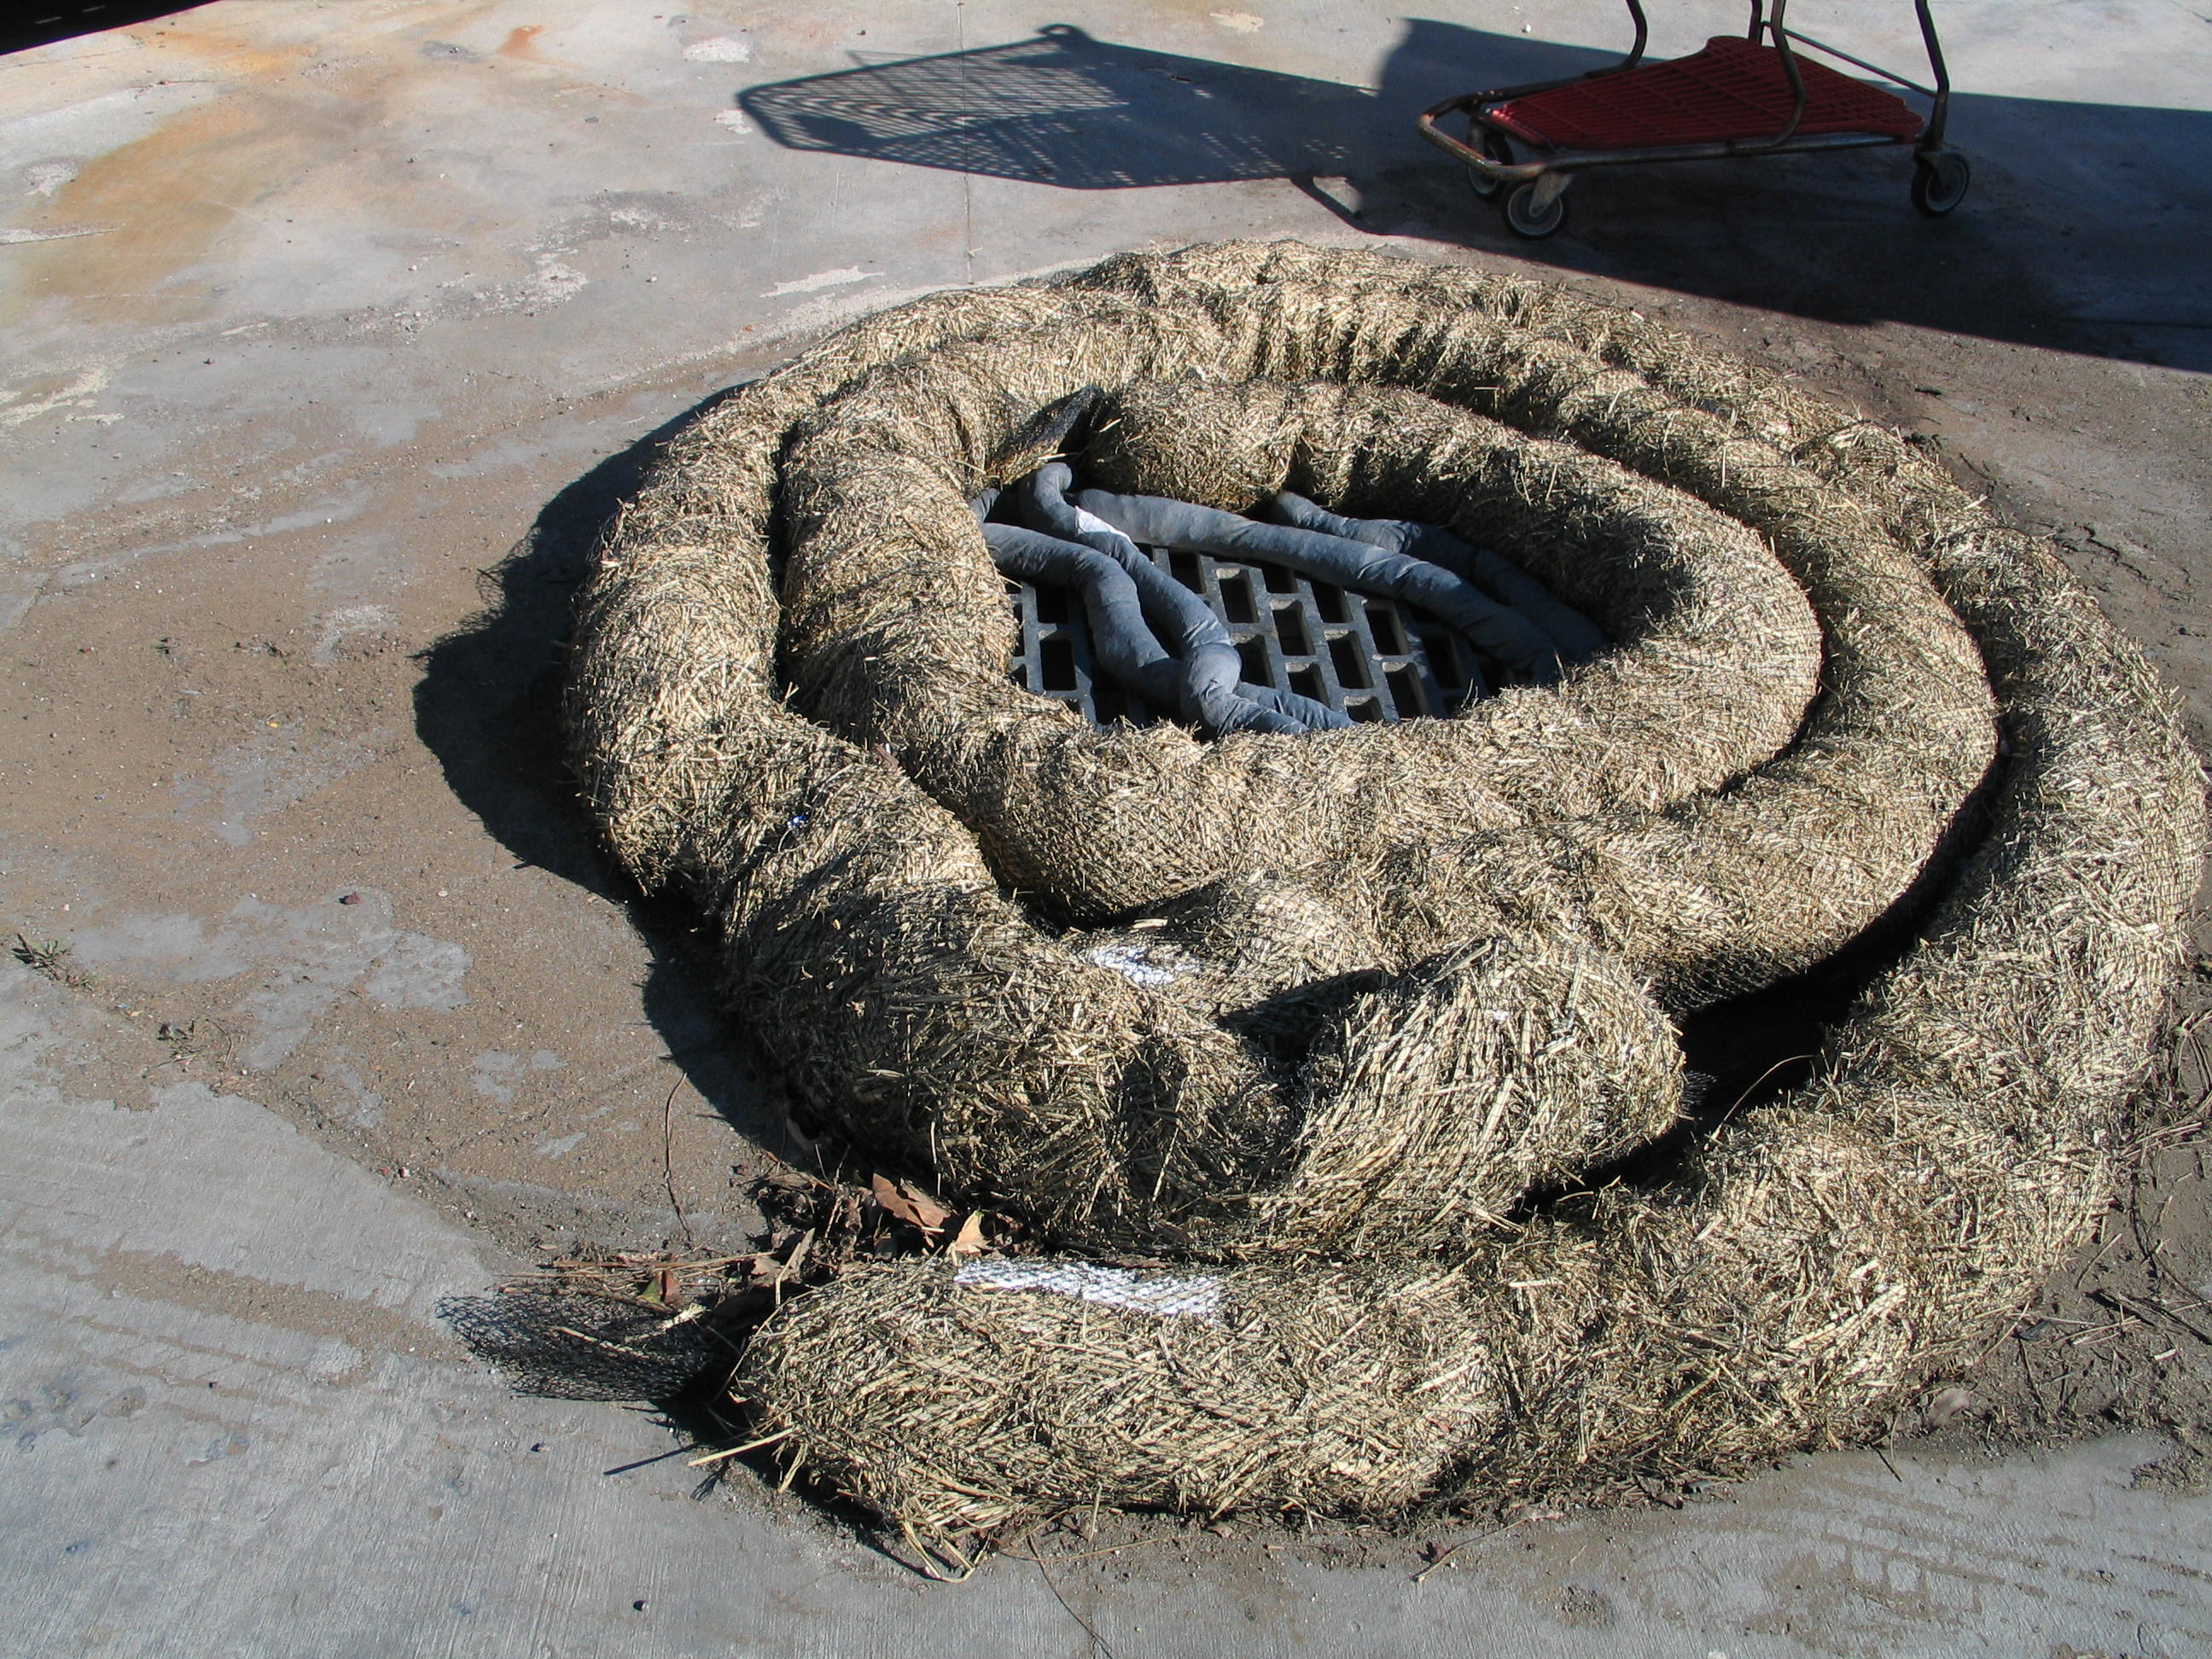

Slide 41
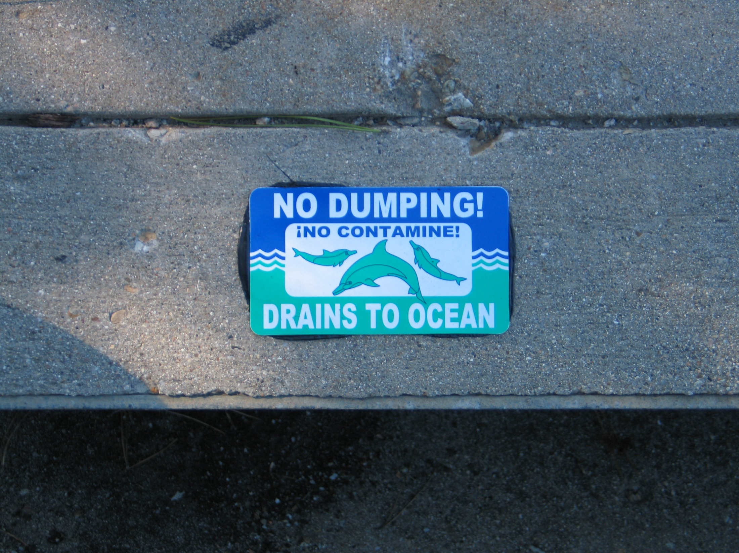

Slide 42
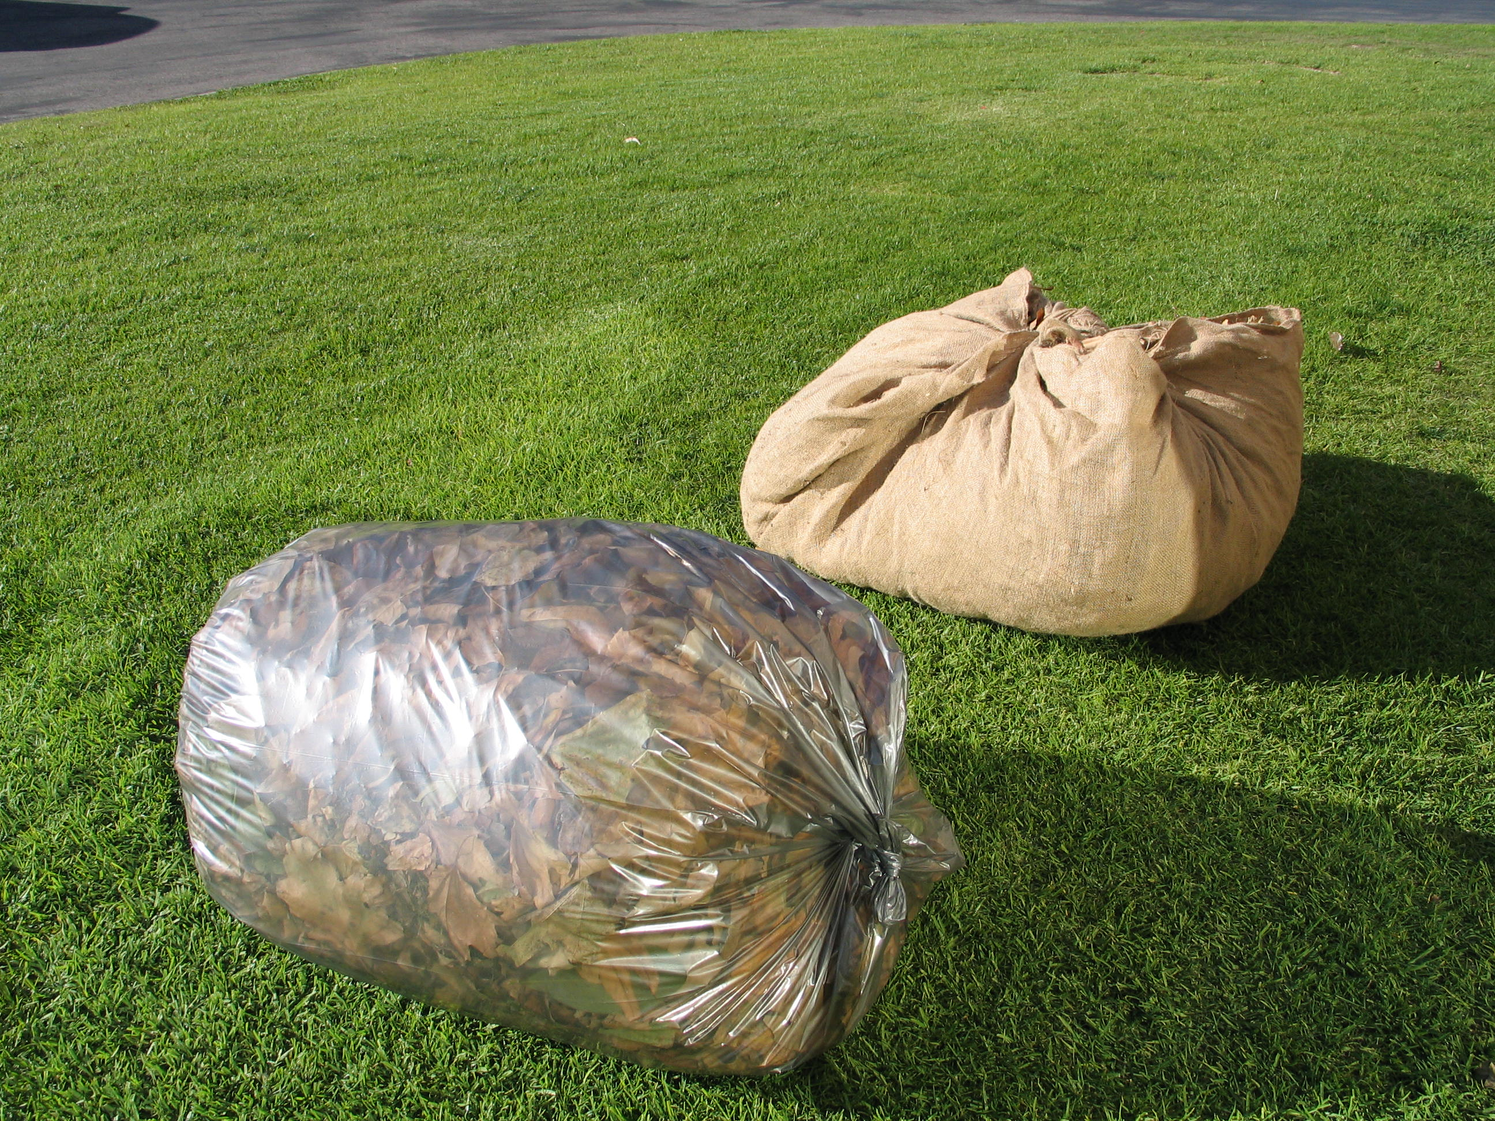

Slide 43
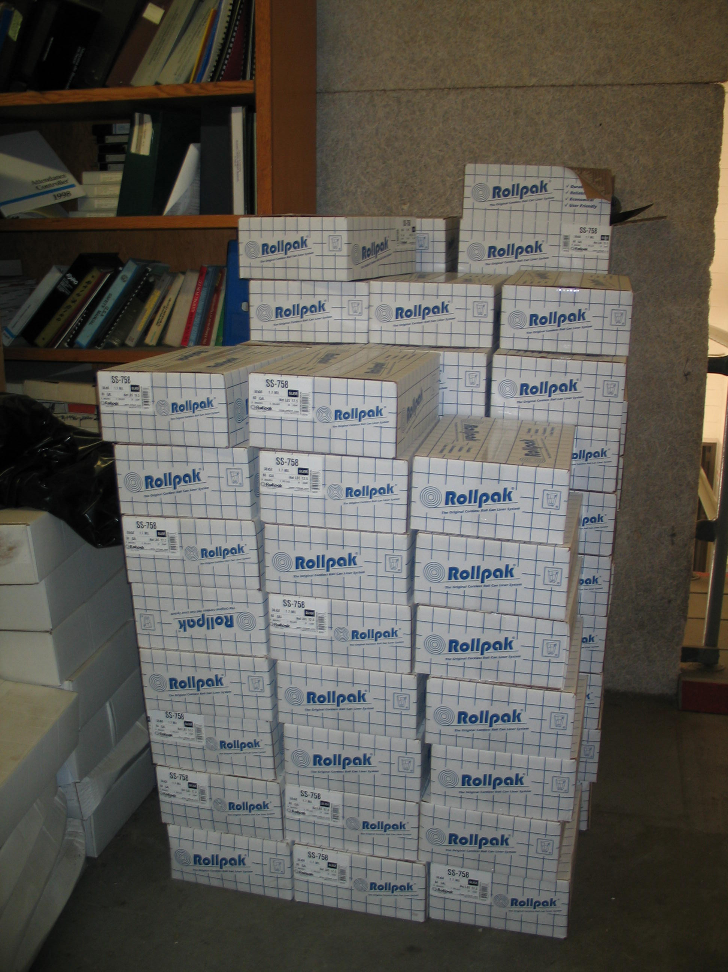

Slide 44
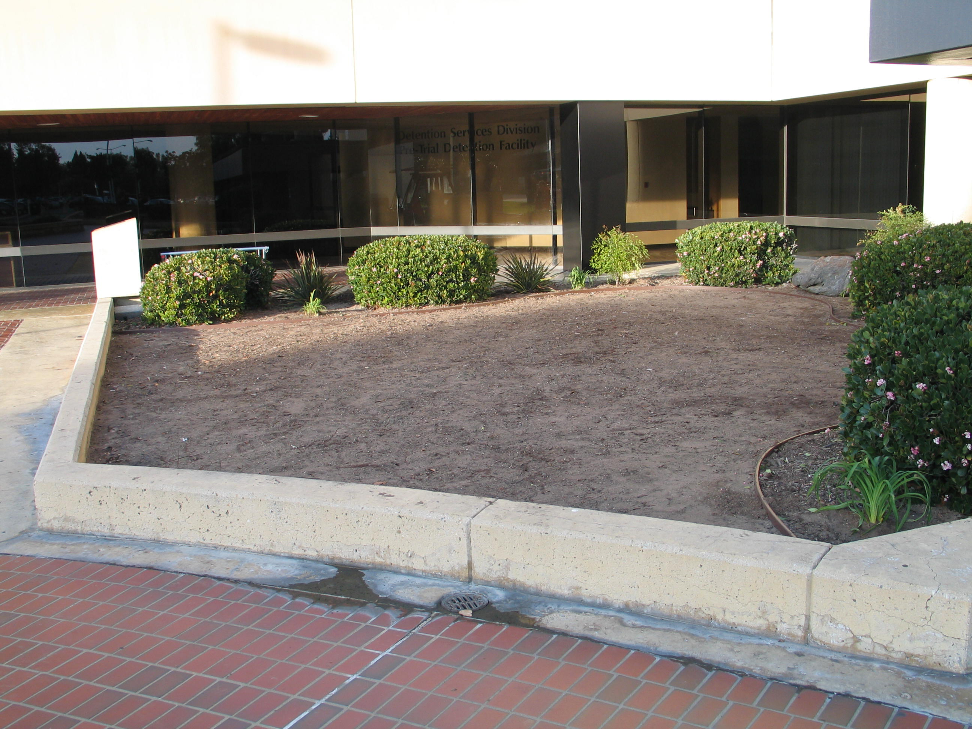

Slide 45
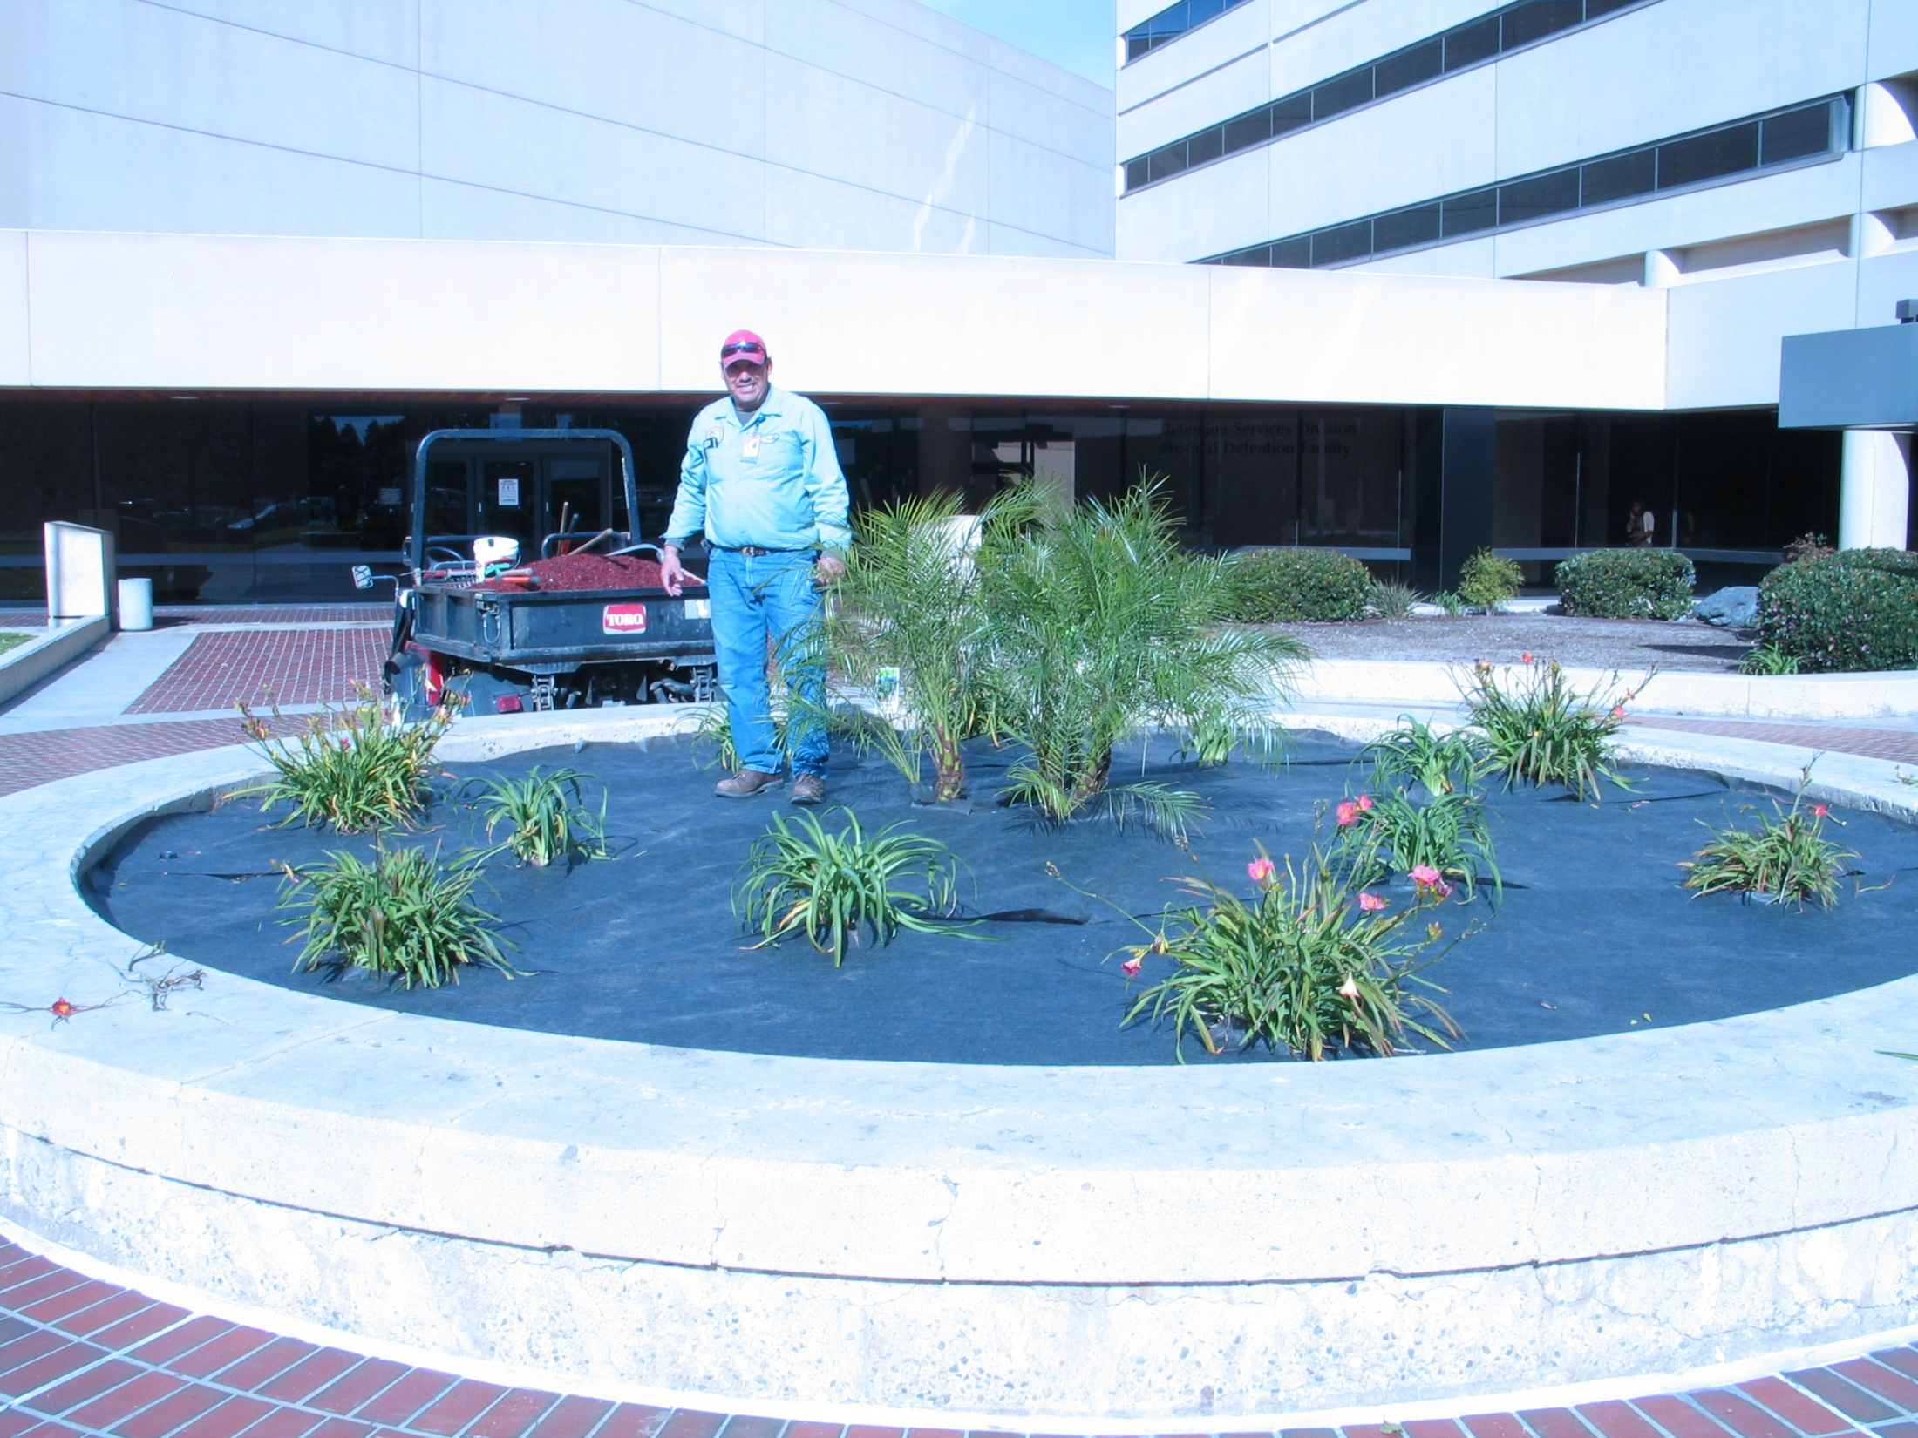

Slide 46
Recycled Mulch

Slide 47
